Slide 1
Wave

Slide 2
Introduction
We have to understand the wave nature of light that was used to find the fact that the speed of light is invariant
Wave can be understood as a collection of simple harmonic oscillations
Today, we study
- Simple Harmonic Oscillation
- Types of Waves
- Diffraction and Interference of Waves
- Demonstrations on these with sound waves

Slide 3
Simple Harmonic Oscillation

Slide 4
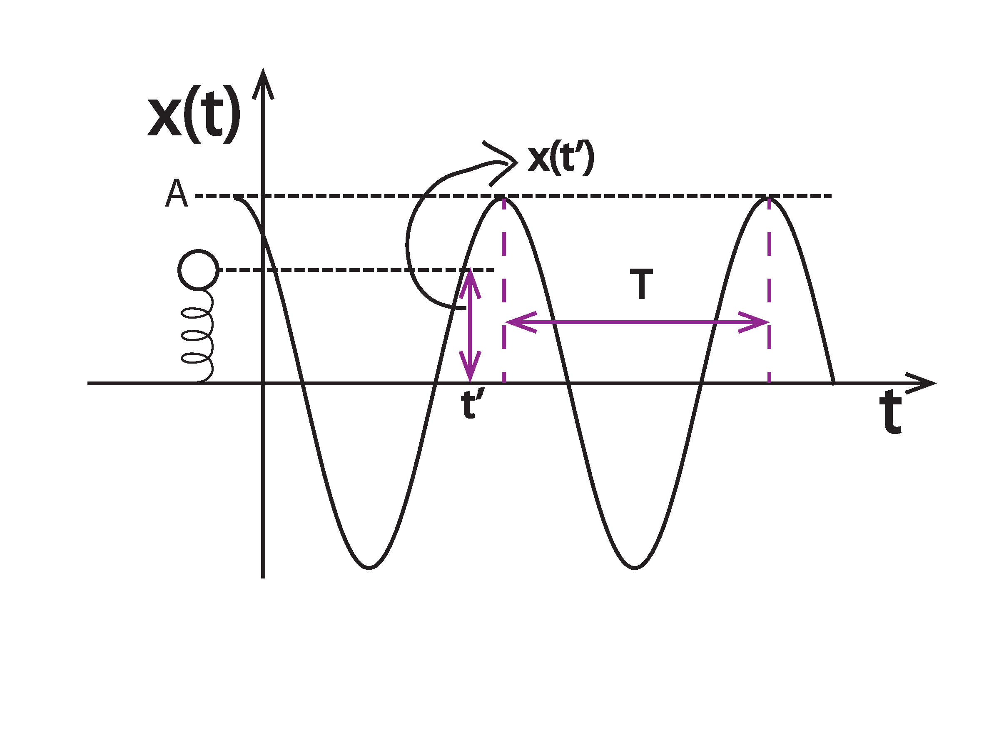
Simple harmonic motion
$x\left(t\right)=A sin\left(ωt+φ\right)$ $=A sin\left[2π\left(\frac{t}{T}\right)+φ\right]$
A mechanical system whose trajectory is sinusoidal

Slide 5
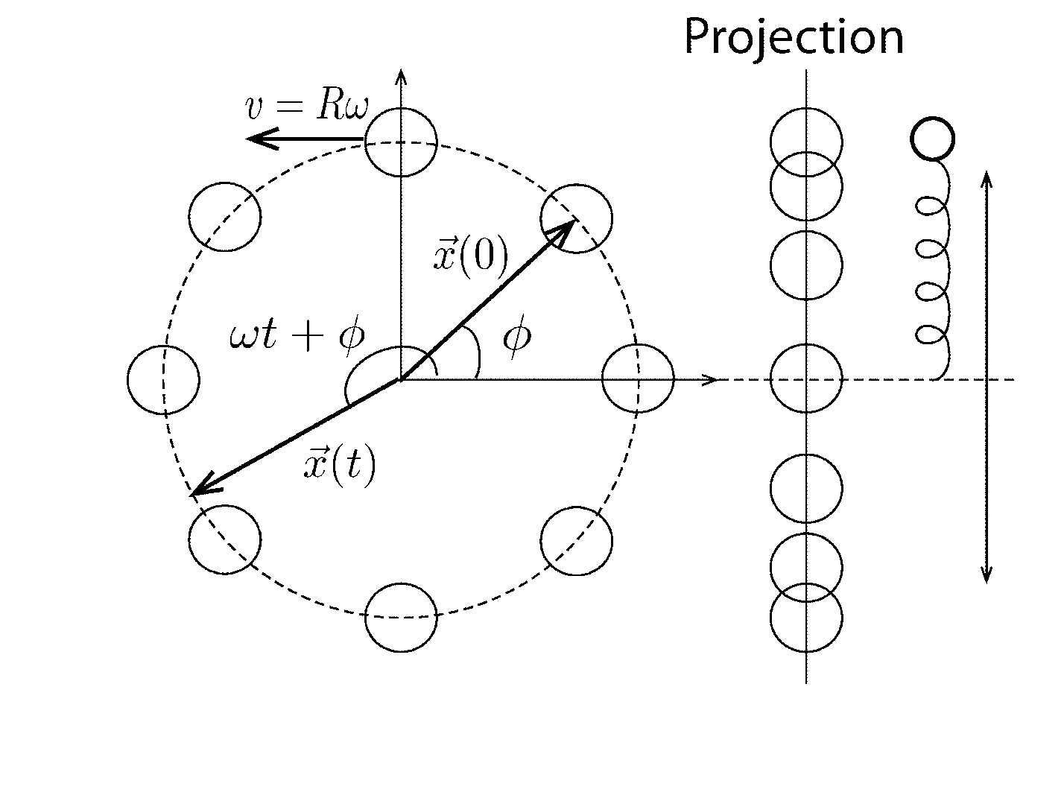
Projection of Uniform Circular Motion is SHO!
Suppose an object making a uniform circular motion in 2 D.
$R=radius, ω=2πf, f=\frac{v}{2πR}, v=speed=Rω$

Slide 6
Projection of Uniform Circular Motion is SHO!
The horizontal and vertical components of the object’s position are
$x\left(t\right)=Rcos\left(ωt+φ\right)$
$y\left(t\right)=Rsin(ωt+φ)$

Slide 7
Examples
Elementary explanation
- part 1 definition (1:56), restoring force (3:20)
- part 2 period(0-3:00),
measuring g(3:00-), measuring m(4:30-)
kinetic and potential energies (5:48-)
SHO of Jupiter’s moons (11:20-)
Another elementary demonstration

Slide 8
Mathematical Structure of SHO
Constructing and Solving the equation of motion for the SHO
- First we construct the equation of motion
using $\vec{F}=m\vec{a}$
- If $F=−kx$, then $\frac{d^{2}x}{dt^{2}} +ω^{2}x=0$, $ω^{2}=k/m$
- The solution to this differential equation is
$$x\left(t\right)=Rcos\left(ωt+φ\right)$$
- This motion can be found in many situations
like pendulum, guitar string, and so forth.
- relation with the uniform circular motion
- total mechanical energy conservation

Slide 9
What is the wave? This is a wave and another

Slide 10
Definitions of Terminologies
Terminologies are explained in a high-school physics course.
Advanced demonstration on the electromagentic wave by Bob Richardson at Cornell.

Slide 11
Sound is a wave
그림출처: http://en.wikipedia.org/wiki/File:Lightning3.jpg

Slide 12
Source of Sound
Objects that vibrate
String, Bell, Drum, …
Vibrations compress and decompress the medium like air periodically
Longitudinal sound wave is generated and propagates in the medium

Slide 13
Why is the sound a wave
Diffraction and interference are the most important characteristics of an wave.
Diffraction:
- You can hear the sound in this case
- acoustic diffraction around a small barrier
Interference:
- Beating is an evidence that sound is an wave

Slide 14
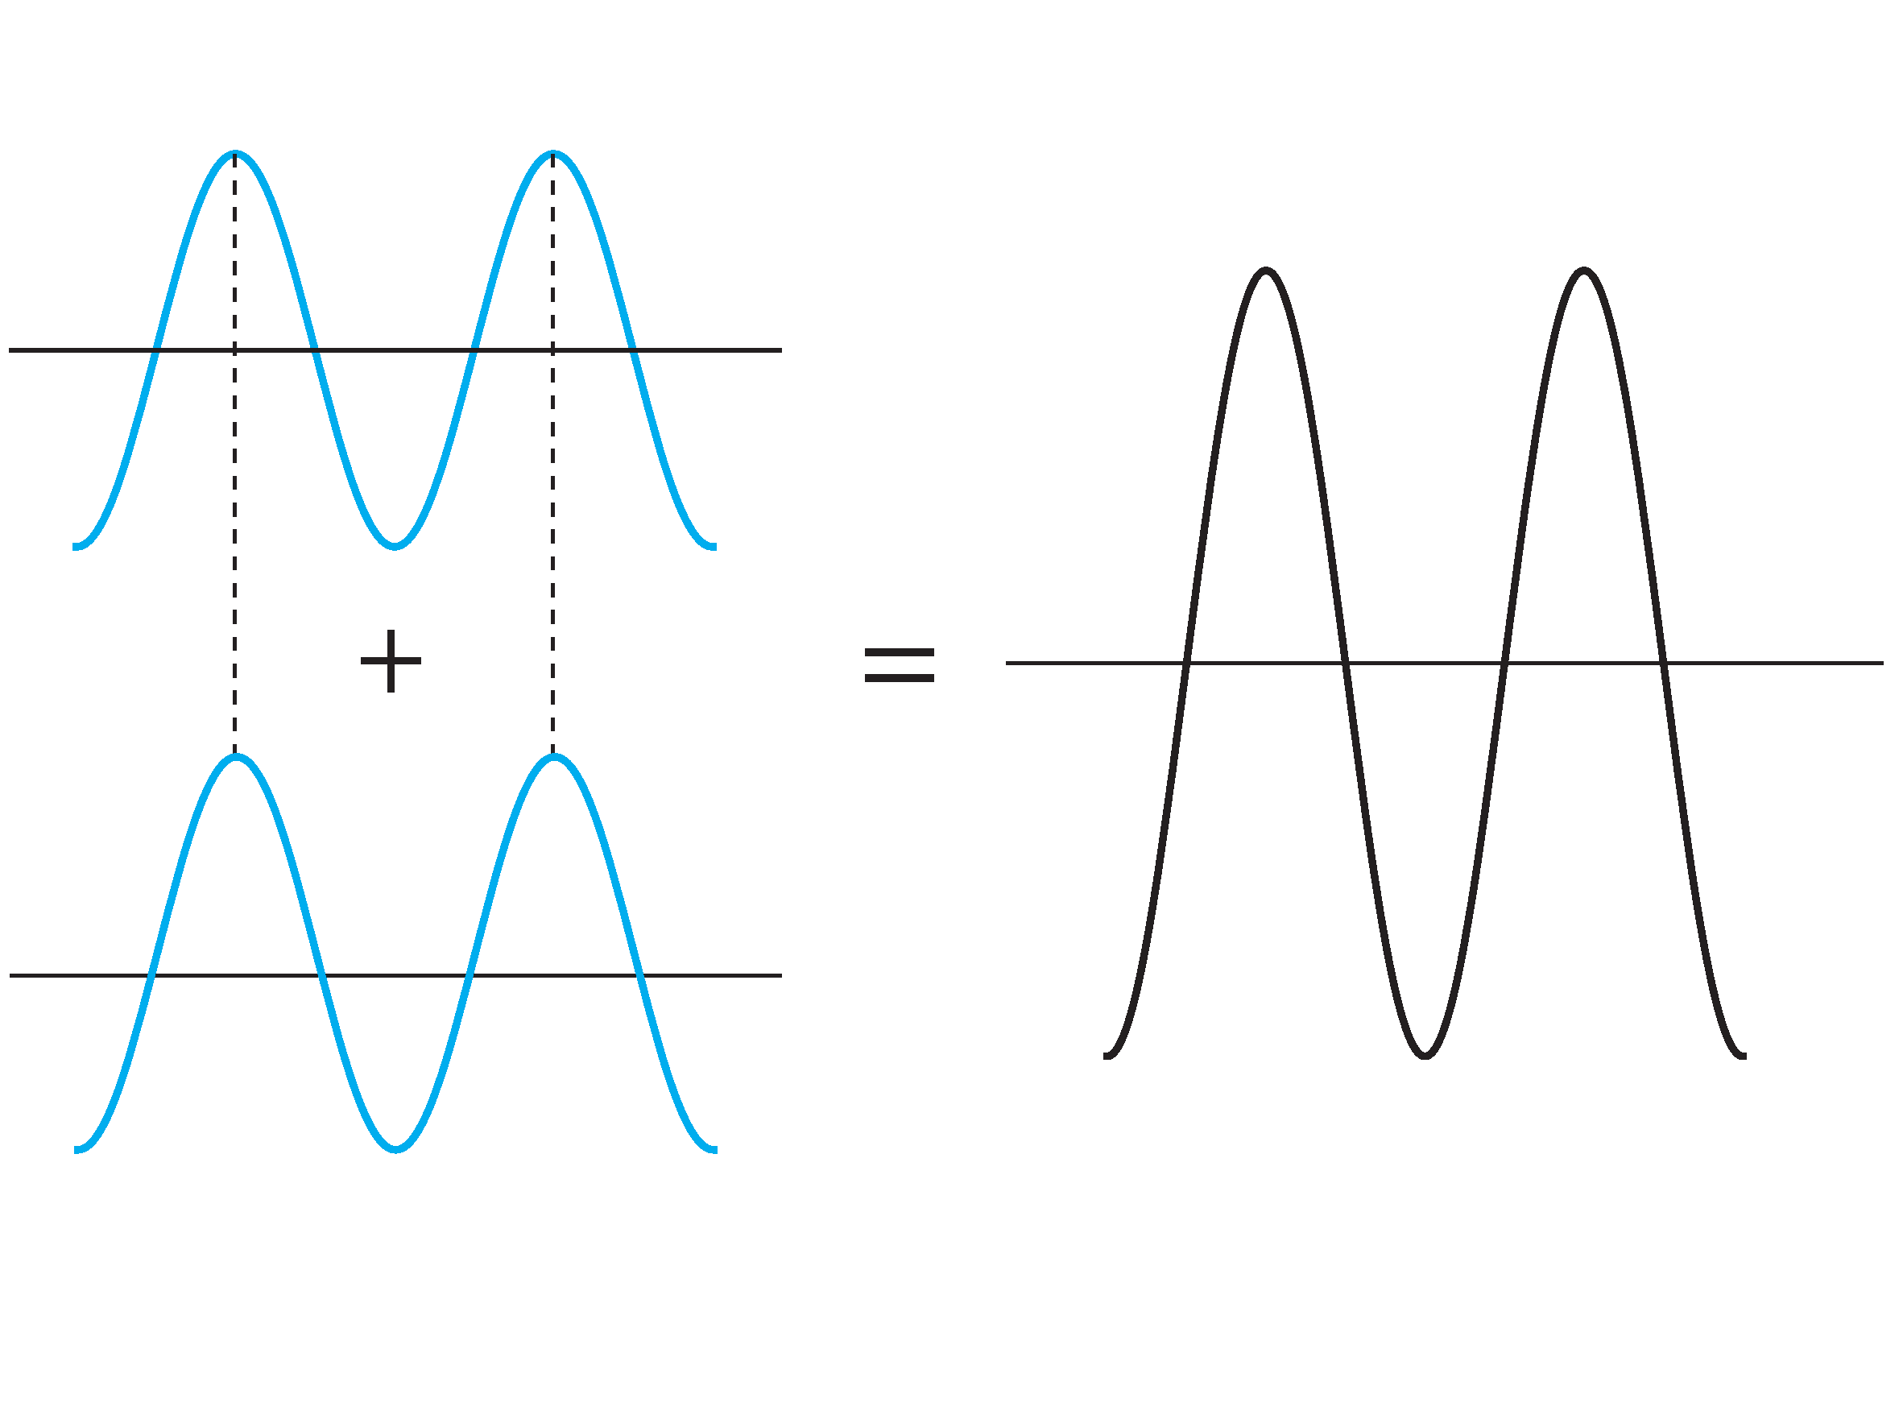
Interference
According to superposition principle, waves are additive
Constructive interference amplifies the resultant wave

Slide 15
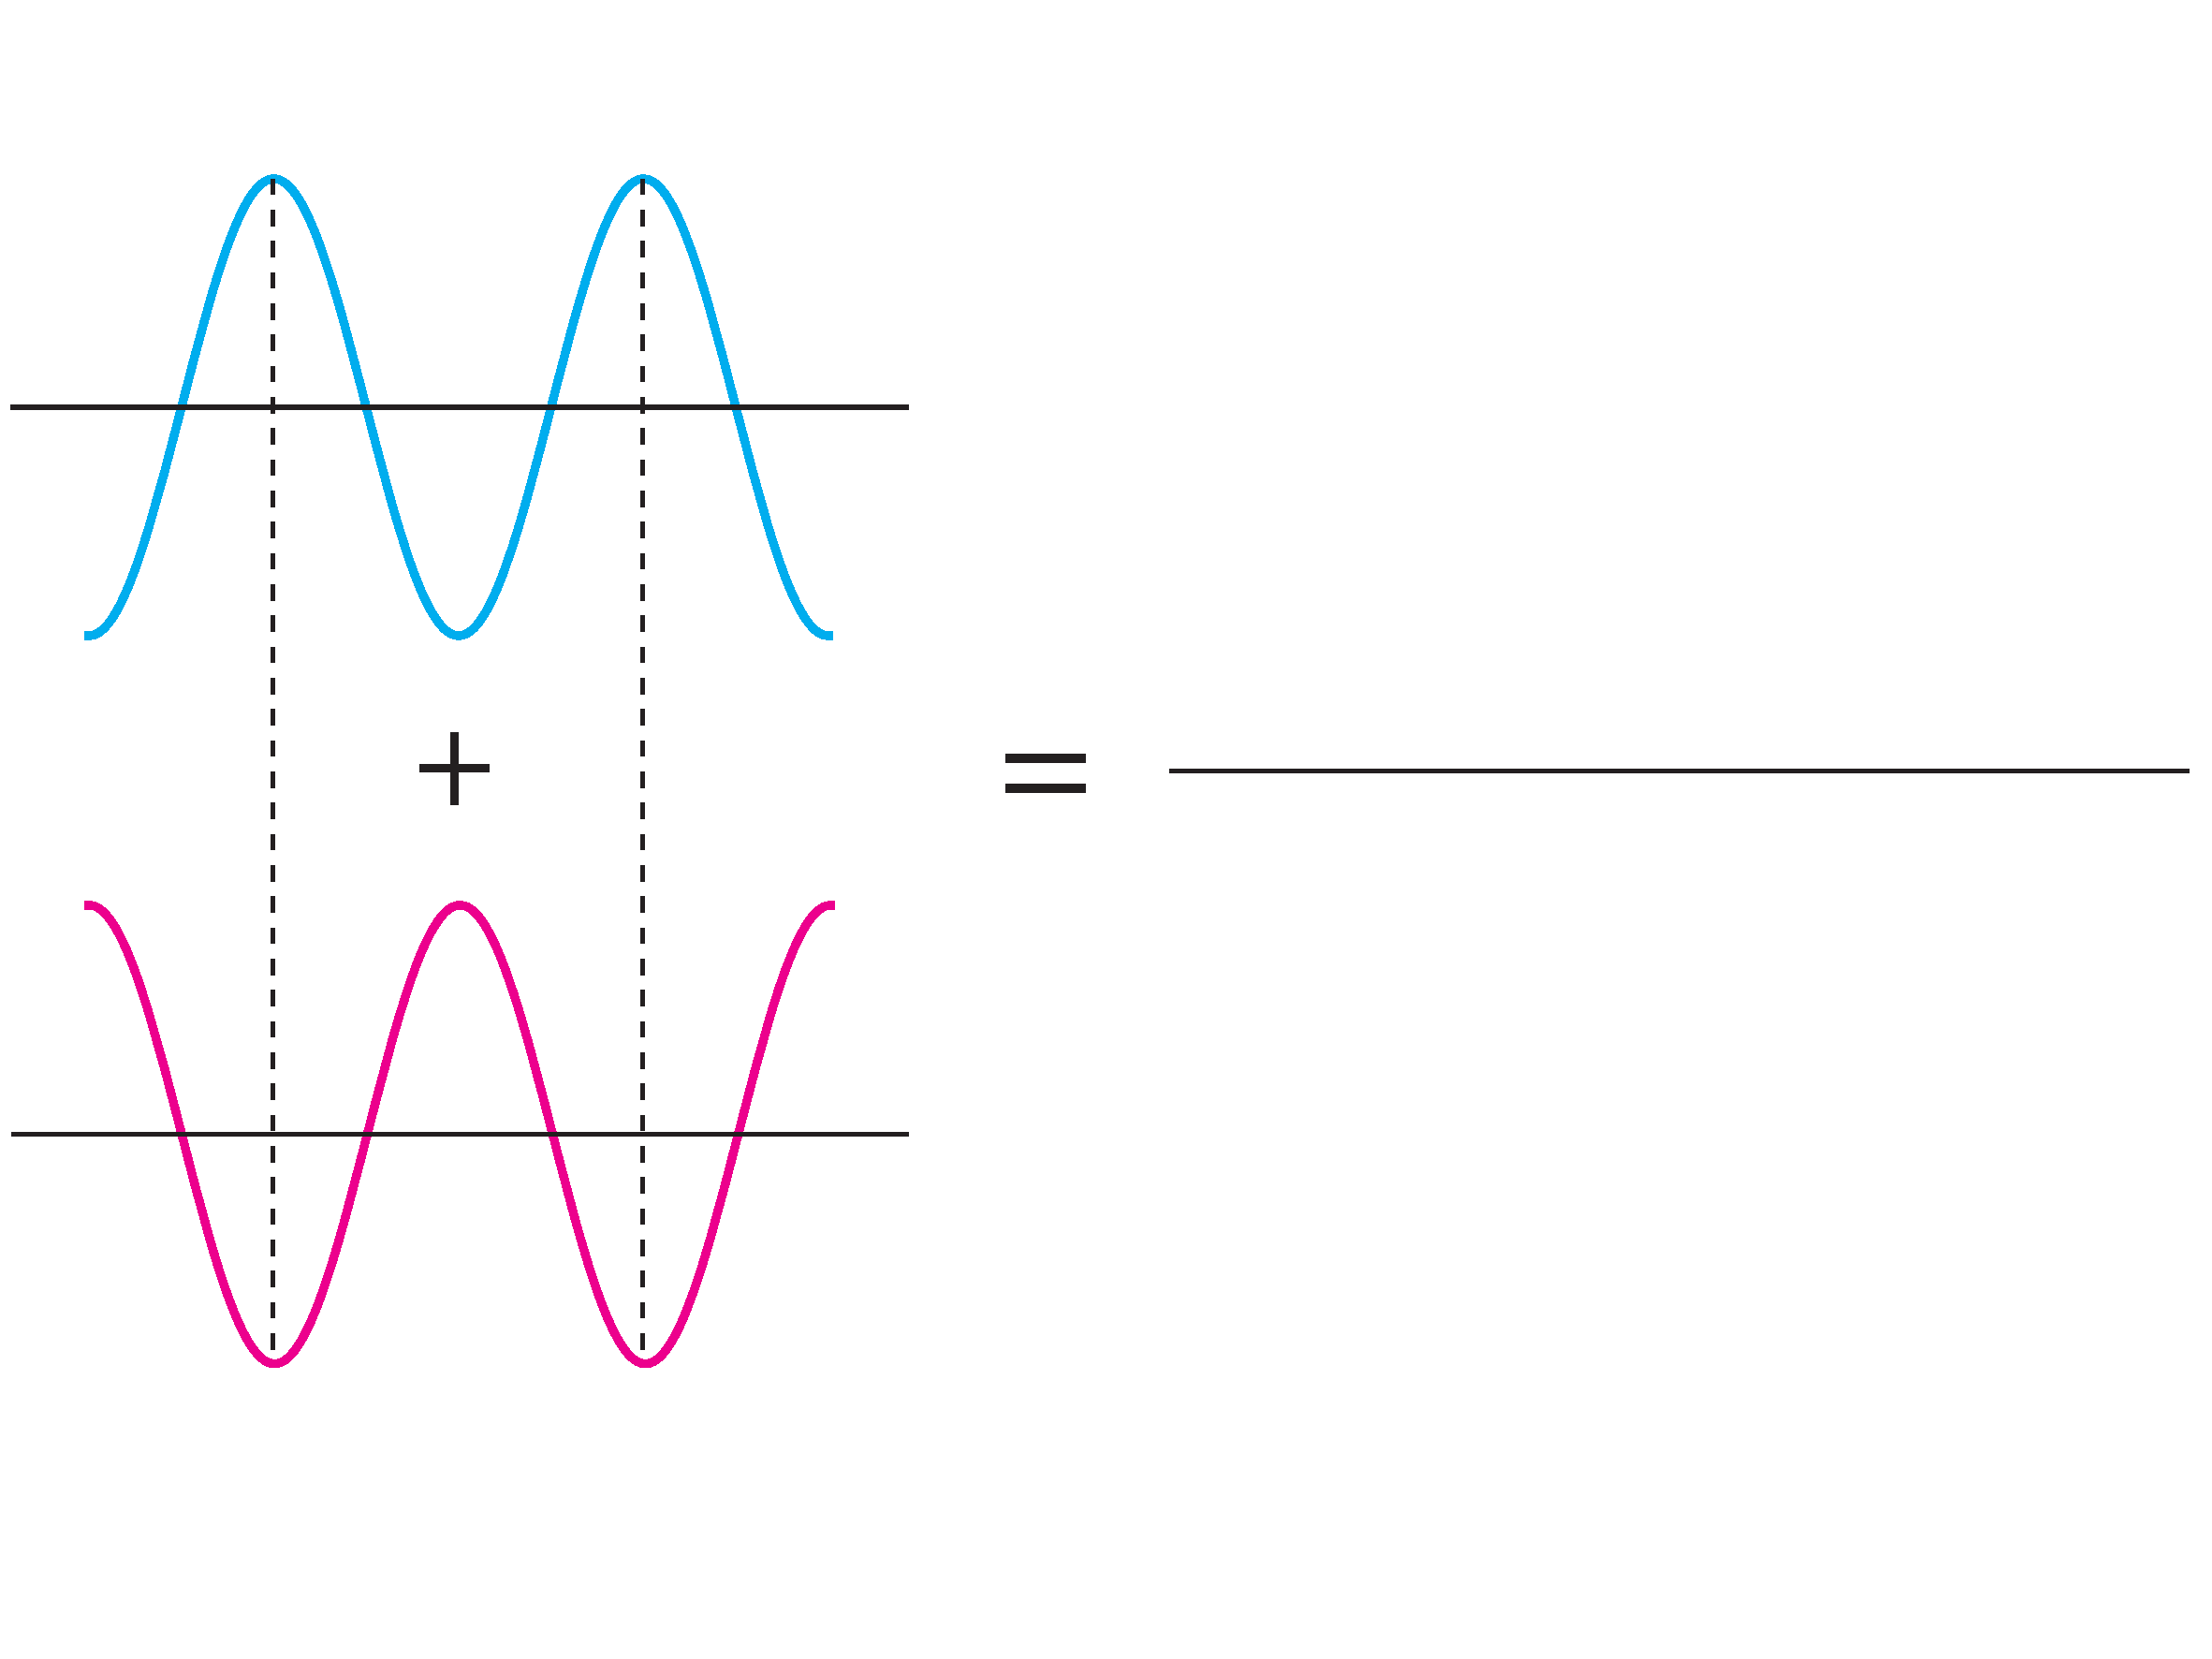
Destructive Interference
If two wave out of phase (differ in the phase by 180 degrees), the resultant wave vanishes

Slide 16
Physics of sound
Vibration, frequency, wavelength of sound
Physics of sound from musical instruments
Interesting lecture on harmonics and pitch(frequency)
Shock wave generated from supersonic plane
if the source of sound travels faster than the
speed of sound

Slide 17
Speed of Sound
Gas (air) and Liquid (water)
- longitudinal wave
v(gas) < v(liquid) < v(solid)
The speed of sound depends on the medium as well as the temperature
- v(air)=343 m/s at 20 ℃ (=1230 km/h)
- v(water)=1480 m/s
- v(steel)=5800 m/s
- v(diamond)=12 km/s (=43,000 km/h)

Slide 18
Speed of wave on a string
$v=\sqrt{\frac{T}{ μ}} , T=tension, μ=mass$
$Frequency f=\frac{1}{T^{′}}=\frac{v}{λ}, T^{′}=period$ -with the same string, if frequency increases, then the velocity of the wave increases
More explanation on the guitar string vibration
Increase the tension → pitch (frequency) and velocity increase

Slide 19
Why v(solid)>v(liquid)>v(gas)?
Based on the guitar string vibration, we expect that the speed of sound wave in the string increases as the restoring force increases.
The tension is stronger for a medium which is hard to compress!

Slide 20
Standing Wave and Harmonics
그림출처: http://en.wikipedia.org/wiki/File:Lightning3.jpg

Slide 21
Standing wave on a string
If there are 2 identical waves that are making head-on collision, the resultant wave (interference pattern) is standing.
Red dot: node, blue wave →, red wave ←
We call this a standing wave.
그림출처: http://en.wikipedia.org/wiki/File:Standing_wave_2.gif

Slide 22
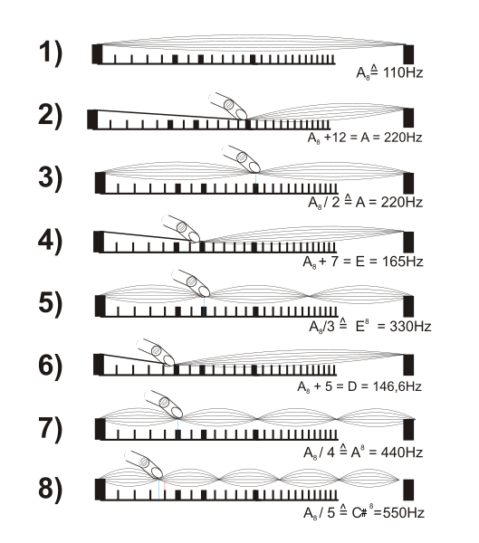
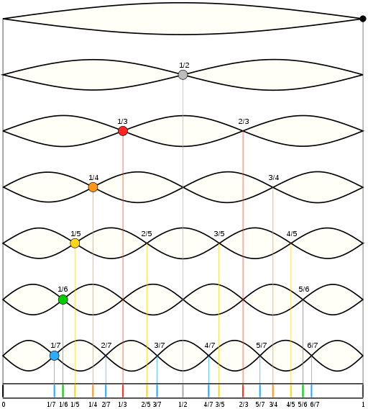
Harmonics
The nodes of a vibrating string are harmonics

Slide 23
Harmonics
Fundamental frequency: Minimum single frequency of sinusoidal wave on a string
2nd Harmonic: second lowest single frequency of sinusoidal wave on that string
3rd Harmonic: and so on
Real sound wave is a combination of various waves of different frequencies (synthesizer)
Actual sound of an instrument contains various harmonics. It depends on the instrument.

Slide 24
Demonstration of Standing Wave
Demonstration of the standing wave
Example:
violin, guitar, … : various string instruments
그림출처: http://en.wikipedia.org/wiki/File:Standingwaves.svg

Slide 25
Octave
Consider a sound of frequency 440 Hz
The sound with 880 Hz is one octave above
220 Hz is one octave below
The frequency increases by powers of 2 as octave is enhanced
그림출처: http://en.wikipedia.org/wiki/File:Standingwaves.svg

Slide 26
Timbre
Even though we play the same notes, the sound of each instrument is distinctive to any other else. Timbre is that color of sound of the instrument.
Compare three pianos in timber
The physical reason for the difference in timber is the combination of harmonics in the sound generated by each instrument.
Combination of various harmonics that even includes 7 harmonics

Slide 27
Physics in tuning a musical instrument
그림출처: http://en.wikipedia.org/wiki/File:Lightning3.jpg

Slide 28
Fundamental Formula
The simple harmonic oscillator has the angular frequency
$$ω=\sqrt{\frac{k}{m} }$$
The frequency is then $f=\frac{ω}{2π}=\frac{1}{2π} \sqrt{\frac{k}{M}}$ k is proportional to the restoring force M is proportional to the inertia of the medium

Slide 29
Fundamental Formula
In a string vibration, it becomes
$$f=\frac{ω}{2π}=\frac{1}{2π} \sqrt{\frac{T}{μ}}$$ T= tension
$μ$=mass per unit length

Slide 30
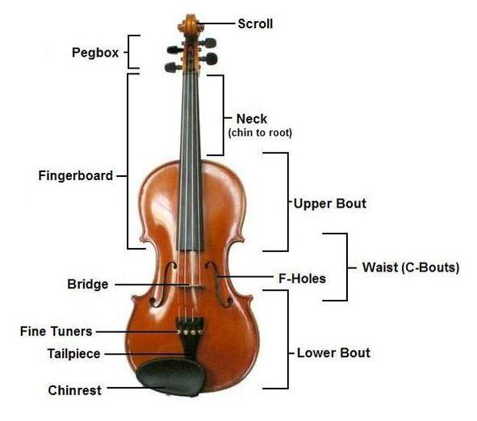
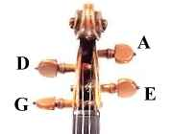
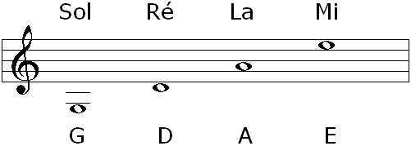
Structure of a Violin
그림출처: (좌) http://upload.wikimedia.org/wikipedia/commons/c/cc/Violinconsruction3.JPG
(우상) http://upload.wikimedia.org/wikipedia/commons/4/4a/Violin_peg_strings.jpg
(우하) http://en.wikipedia.org/wiki/File:Violin_-_open_strings_notes.PNG

Slide 31
Change tension to tune
How to tune violin strings 1,
Lengths of the four strings
are identical
What are the differences of the four strings?
Tuning process is
A→D→G→E
Why this order?
Why should you begin
with lower note (less tension)?
(우상) http://upload.wikimedia.org/wikipedia/commons/4/4a/Violin_peg_strings.jpg
(우하) http://en.wikipedia.org/wiki/File:Violin_-_open_strings_notes.PNG

Slide 32
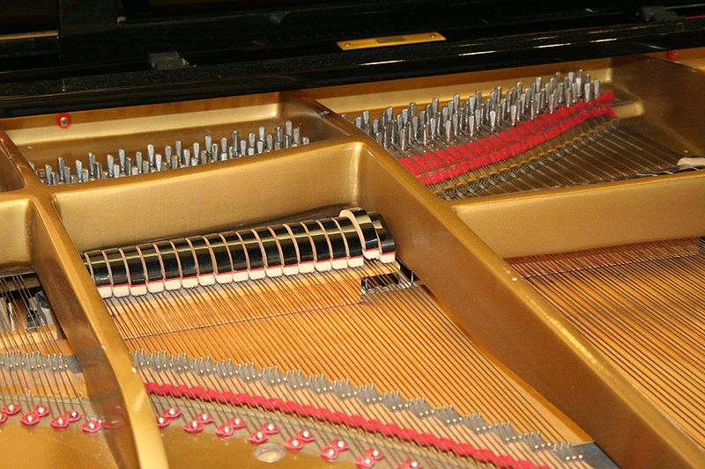
Length and Density of the string
Watch the string of a piano density & length
Can you distinguish the right hand side of the key board, which is higher in tone?
그림출처: http://en.wikipedia.org/wiki/File:Piano_inside.jpg

Slide 33
Change the length and density of the string
Watch the video for general information
Watch the length and the thickness of the piano string (0:47-)
A string for a higher tone is thinner and shorter than those for a lower tone
Recall the formula
$$f=\frac{1}{2π}\sqrt{\frac{T}{μ}}$$

