Slide 1
Lorentz Transformation

Slide 2
We know that
In the rest frame space-time coordinate of a clock fixed at the origin is ($cτ$,$0$)
In the frame where the clock is moving with velocity $v,$ the space-time coordinate becomes ($ct, vt)$.
Time dilation states that
$$t=γτ, γ=\frac{1}{\sqrt{1−v^{2}/c^{2}}}$$
Applying the matrix method, we find the Lorentz transformation matrix today.

Slide 3
Event as a Four vector
For the time being, we neglect y and z axes.
In the rest frame $S,$ the four-vector
$X=\left(\begin{matrix}cτ \\ 0\end{matrix}\right)$ represents the event ($cτ$,$0$).
In the moving frame $S′,$ the same event is described by $X′=\left(\begin{matrix}ct \\ vt\end{matrix}\right)=\left(\begin{matrix}cγτ \\ vγτ\end{matrix}\right)$.
Note that the frame $S′$ moves with the velocity $−v$ with respect to $S$.
In the frame $S′$, frame $S$ is moving with $+v$.

Slide 4
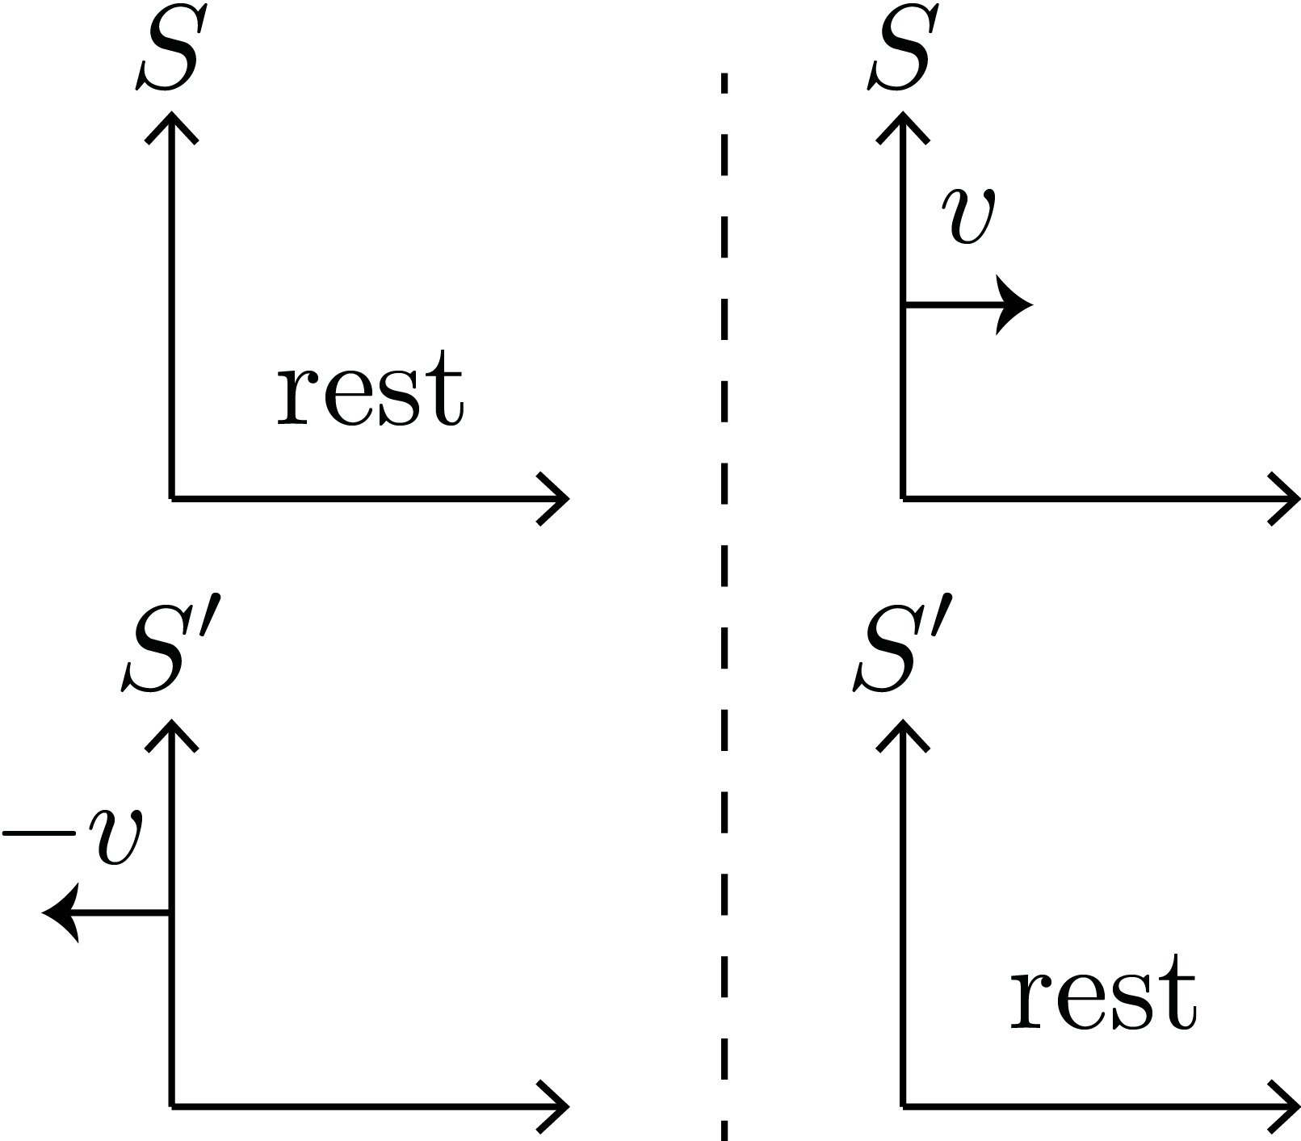
Note that
Note that the frame $S′$ moves with the velocity $−v$ with respect to $S$.
In the frame $S′$, frame $S$ is moving with $+v$.

Slide 5
Let us find the boost matrix $Λ$
In the rest frame $S,$ the four-vector
$X=\left(\begin{matrix}cτ \\ 0\end{matrix}\right)$ represents the event ($cτ$,$0$).
In the moving frame $S′,$ the same event is described by $X′=\left(\begin{matrix}ct \\ vt\end{matrix}\right)$.
We want to find the Lorentz boost matrix $Λ$ such that
$X^{′}=ΛX, X=\left(\begin{matrix}cτ \\ 0\end{matrix}\right),{ X}^{′}=\left(\begin{matrix}ct \\ vt\end{matrix}\right), Λ=\left(\begin{matrix}a & b \\ p & q\end{matrix}\right).$

Slide 6
First trial
$X^{′}=ΛX, X=\left(\begin{matrix}cτ \\ 0\end{matrix}\right),{ X}^{′}=\left(\begin{matrix}ct \\ vt\end{matrix}\right), Λ=\left(\begin{matrix}a & b \\ p & q\end{matrix}\right).$
This leads to
$$\left(\begin{matrix}ct \\ vt\end{matrix}\right)=\left(\begin{matrix}a & b \\ p & q\end{matrix}\right)\left(\begin{matrix}cτ \\ 0\end{matrix}\right)$$
$$\left(\begin{matrix}cγτ \\ vγτ\end{matrix}\right)=\left(\begin{matrix}acτ \\ pcτ\end{matrix}\right) →\left(\begin{matrix}γ \\ \frac{v}{c}γ\end{matrix}\right)=\left(\begin{matrix}a \\ p\end{matrix}\right)$$
This determines $a=γ, p=\frac{v}{c}γ$

Slide 7
Inverse matrix $Λ^{−1}$
We find that $Λ=\left(\begin{matrix}γ & b \\ \frac{v}{c}γ & q\end{matrix}\right).$ Here, $b$ and $q$are not determined, yet.
Based on the relativity of the two frames, the inverse matrix must be obtained by replacing $v$ with $−v:$ $γ→γ$ and $\frac{v}{c}γ→−\frac{v}{c}γ$.
Therefore, $Λ^{−1}=\left(\begin{matrix}γ & b \\ −\frac{v}{c}γ & q\end{matrix}\right)$.

Slide 8
Second trial with inverse
$X=Λ^{−1}X^{′}, X=\left(\begin{matrix}cτ \\ 0\end{matrix}\right),{ X}^{′}=\left(\begin{matrix}ct \\ vt\end{matrix}\right),$
$Λ^{−1}=\left(\begin{matrix}γ & b′ \\ −\frac{v}{c}γ & q′\end{matrix}\right)$, $b′$ and $q′$ may not be the same as $b$ and $q,$ respectively.
This leads to
$$\left(\begin{matrix}cτ \\ 0\end{matrix}\right)=\left(\begin{matrix}γ & b′ \\ −\frac{v}{c}γ & q′\end{matrix}\right)\left(\begin{matrix}cγτ \\ vγτ\end{matrix}\right)$$
$$\left(\begin{matrix}cτ \\ 0\end{matrix}\right)=\left(\begin{matrix}γ^{2}cτ+b′vγτ \\ −vγ^{2}τ+q′vγτ\end{matrix}\right) →\left(\begin{matrix}1 \\ 0\end{matrix}\right)=\left(\begin{matrix}γ^{2}+b′\frac{v}{c}γ \\ −γ+q′\end{matrix}\right)$$

Slide 9
The solution is
$\left(\begin{matrix}1 \\ 0\end{matrix}\right)=\left(\begin{matrix}γ^{2}+b′\frac{v}{c}γ \\ −γ+q′\end{matrix}\right)$
The lower equation determines $q^{′}=γ=q.$
$\text{The} \text{lower} \text{equation} \text{determines}$
$b′\frac{v}{c}γ=1−γ^{2}=1−\frac{1}{1−\frac{v^{2}}{c^{2}}}=\frac{1−\frac{v^{2}}{c^{2}}−1}{1−\frac{v^{2}}{c^{2}}}=\frac{−\frac{v^{2}}{c^{2}}}{1−\frac{v^{2}}{c^{2}}}$
$b′=−\frac{v}{c}\frac{\sqrt{1−\frac{v^{2}}{c^{2}}}}{1−\frac{v^{2}}{c^{2}}}$ = $−\frac{v}{c}\frac{1}{\sqrt{1−\frac{v^{2}}{c^{2}}}}$=$−\frac{v}{c}γ→b=\frac{v}{c}γ$

Slide 10
Therefore, the boost matrix is
$Λ=\left(\begin{matrix}γ & +\frac{v}{c}γ \\ +\frac{v}{c}γ & γ\end{matrix} \right)$ $=\left(\begin{matrix}γ & +βγ \\ +βγ & γ\end{matrix} \right)$
$Λ^{−1}=\left(\begin{matrix}γ & −\frac{v}{c}γ \\ −\frac{v}{c}γ & γ\end{matrix} \right)$ $=\left(\begin{matrix}γ & −βγ \\ −βγ & γ\end{matrix} \right)$
$β=\frac{v}{c}$ , $γ=\frac{1}{\sqrt{1−\frac{v^{2}}{c^{2}}}}$ , $βγ=\frac{\frac{v}{c}}{\sqrt{1−\frac{v^{2}}{c^{2}}}}$

Slide 11
Lorentz Boost is obtained!
$X^{′}=ΛX$
$\left(\begin{matrix}ct \\ vt\end{matrix}\right)=\left(\begin{matrix}γ & +\frac{v}{c}γ \\ +\frac{v}{c}γ & γ\end{matrix} \right)\left(\begin{matrix}cτ \\ 0\end{matrix}\right)$
$\left(\begin{matrix}cτ \\ 0\end{matrix}\right)=\left(\begin{matrix}γ & −\frac{v}{c}γ \\ −\frac{v}{c}γ & γ\end{matrix} \right)\left(\begin{matrix}ct \\ vt\end{matrix}\right)$

Slide 12
Recall that R is universal!
When we derived the rotation matrix $R,$ we used the transformation properties of unit vectors like $\left(\begin{matrix}1 \\ 0\end{matrix}\right)$ and $\left(\begin{matrix}0 \\ 1\end{matrix}\right)$. This is the same as $\left(\begin{matrix}cτ \\ 0\end{matrix}\right)$ in the determination of $Λ$.
Then we used the matrix for any vectors $X$: $X^{′}=RX$.
We guess that the boost matrix transforms any four vector $X=\left(\begin{matrix}ct \\ x\end{matrix}\right)$.

Slide 13
For a general space-time point,
$X^{′}=ΛX,$
$$\left(\begin{matrix}ct′ \\ x′\end{matrix}\right)=\left(\begin{matrix}γ & +\frac{v}{c}γ \\ +\frac{v}{c}γ & γ\end{matrix} \right)\left(\begin{matrix}ct \\ x\end{matrix}\right)$$
$X=Λ^{−1}X′,$
$$\left(\begin{matrix}ct \\ x\end{matrix}\right)=\left(\begin{matrix}γ & −\frac{v}{c}γ \\ −\frac{v}{c}γ & γ\end{matrix} \right)\left(\begin{matrix}ct′ \\ x′\end{matrix}\right)$$

Slide 14
If we include transverse components that are invariant,
$X^{′}=ΛX, \left(\begin{matrix}ct′ \\ \begin{aligned}x′ \\ y′ \\ z′\end{aligned}\end{matrix}\right)=\left(\begin{aligned}\begin{matrix}γ & +βγ \\ +βγ & γ\end{matrix} \begin{matrix}0 & 0 \\ 0 & 0\end{matrix} \\ \begin{matrix} 0 & 0 \\ 0 & 0\end{matrix} \begin{matrix}1 & 0 \\ 0 & 1\end{matrix}\end{aligned}\right)\left(\begin{matrix}ct \\ \begin{aligned}x \\ y \\ z\end{aligned}\end{matrix}\right)$
$X=Λ^{−1}X^{′}, \left(\begin{matrix}ct \\ \begin{aligned}x \\ y \\ z\end{aligned}\end{matrix}\right)=\left(\begin{aligned}\begin{matrix}γ & −βγ \\ −βγ & γ\end{matrix} \begin{matrix}0 & 0 \\ 0 & 0\end{matrix} \\ \begin{matrix} 0 & 0 \\ 0 & 0\end{matrix} \begin{matrix} 1 & 0 \\ 0 & 1\end{matrix}\end{aligned}\right)\left(\begin{matrix}ct′ \\ \begin{aligned}x′ \\ y′ \\ z′\end{aligned}\end{matrix}\right)$

Slide 15
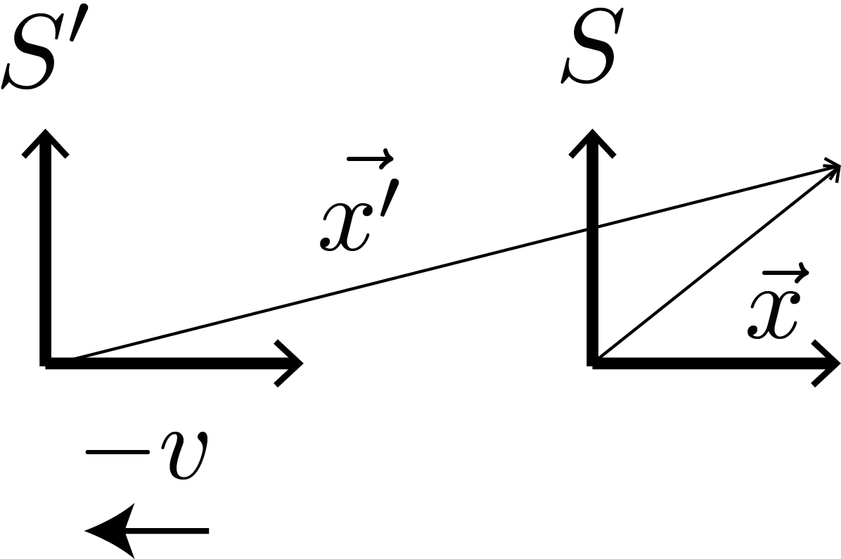
For a general space-time point, Lorentz transformation is
$t′=γ(t+\frac{v}{c^{2}}x),$
$x^{′}=γ\left(x+vt\right), y^{′}=y, { z}^{′}=z$
$t=γ(t^{′}−\frac{v}{c^{2}}x′),$
$x=γ\left(x^{′}−vt′\right), y=y^{′}, z=z′$

Slide 16
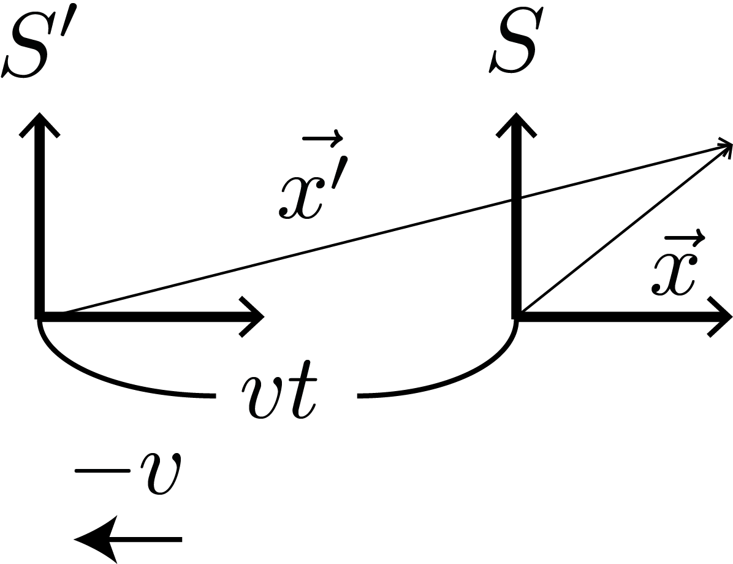
In the limit $\frac{v}{c}→0$
In the non-relativistic limit $\frac{v}{c}→0$, $γ→1$and the Lorentz transformation reduces into the Galilean transformation!
$t′=t,$
$x^{′}=x+vt,$
$t=t^{′},$
$x=x^{′}−vt′,$

Slide 17
Check $ΛΛ^{−1}=1$
If we multiply a Lorentz boost matrix $Λ$ and its inverse $Λ^{−1}$, then we must get the identity:
$ΛΛ^{−1}=\left(\begin{matrix}γ & βγ \\ βγ & γ\end{matrix} \right)\left(\begin{matrix}γ & −βγ \\ −βγ & γ\end{matrix} \right)$
$=γ^{2}\left(\begin{matrix}1 & β \\ β & 1\end{matrix} \right)\left(\begin{matrix}1 & −β \\ −β & 1\end{matrix} \right)$
$=γ^{2}\left(\begin{matrix}1−β^{2} & 0 \\ 0 & 1−β^{2}\end{matrix} \right)=\left(\begin{matrix}1 & 0 \\ 0 & 1\end{matrix} \right)$=1
Here, we have used $γ^{2}=1/(1−β^{2}).$
In the same way, we can show that $Λ^{−1}Λ$=1.

Slide 18
Metric Tensor 1 in Euclidean Space
In an Euclidean space, the squared length of a vector is defined by
$$X^{2}≡X^{T}1 X=X^{T}X=x^{2}+y^{2}+z^{2}$$
Here, 1 His called the metric tensor of the 3D Euclidean space.
Orthogonality of Rotation matrix $R^{−1}$=$R^{T}$ requires that the length is invariant under rotation: $X^{′T}X^{′}={\left(RX\right)}^{T}\left(RX\right)=\left(X^{T}R^{T}\right)\left(RX\right)$ $=X^{T}\left(R^{T}R\right)X=X^{T}1 X=X^{T}X$

Slide 19
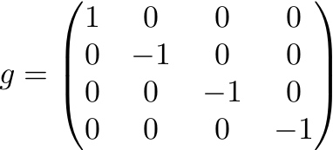
Metric Tensor $g$ in Minkowski Space
In the Minkowski space, where the four-vector transforms, the squared length of a vector is defined by
$$X^{2}≡X^{T}g X={{\left(ct\right)}^{2}−x}^{2}−y^{2}−z^{2}$$
Here, $g$ His called the metric tensor of the 4D Minkowski space.
The matrix representation of $g$ is

Slide 20
Invariant under Lorentz Transform
Under a Lorentz transformation, $X→X^{′}=ΛX.$ Then the squared length transforms like
$$X^{2}→X^{′2}={(ΛX)}^{T}g ΛX$$
$=X^{T}\left(Λ^{T}gΛ\right)X$
Here, $Λ^{T}gΛ$=${\left(\begin{aligned}\begin{matrix}γ & βγ \\ βγ & γ\end{matrix} \\ \end{aligned}\right)}^{T}\left(\begin{aligned}\begin{matrix}1 & 0 \\ 0 & −1\end{matrix} \\ \end{aligned}\right)\left(\begin{aligned}\begin{matrix}γ & βγ \\ βγ & γ\end{matrix} \\ \end{aligned}\right)$
=$\left(\begin{aligned}\begin{matrix}γ & βγ \\ βγ & γ\end{matrix} \\ \end{aligned}\right)\left(\begin{aligned}\begin{matrix}γ & βγ \\ −βγ & −γ\end{matrix} \\ \end{aligned}\right)$
$=g$
Therefore, $X^{2}={\left(ct\right)}^{2}−x^{2}−y^{2}−z^{2}$is invariant!

