Slide 1
Michelson-Morley Experiment

Slide 2
Light is a wave

Slide 3
Why light is a wave
Diffraction
- high-school physics class
- Diffraction gratings
Interference
- simple explanation on Young’s double-slit experiment
- Young’s experiment using a laser
- Advanced experiments
- Thin-film interference

Slide 4
What is the medium of the light wave?

Slide 5
Speed of Light is very large!
Recall that v(air)<v(water)<v(diamond)=12km/s
c=299,792,458 km/s >v(diamond)
If the medium of light wave exists, then it must be harder than diamond and much lighter than that. What is it?
They called the medium of the light wave aether.

Slide 6
Questions on the aether
Light from a far galaxy travels through vacuum.
If aether exists, then it must fill the space even in the vacuum.
Unlike the sound, the light wave is an electromagnetic wave that is transverse.
Therefore, if the light wave is similar to the sound, then the aether, which is very light, but must have properties of solid whose bondage is very strong.

Slide 7
Questions on the aether
Aether is transparent
It must be completely uncompressible
It must not be viscous because the motion of planets does not decelerate

Slide 8
The experiment

Slide 9
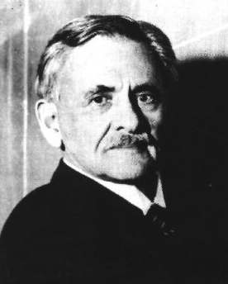
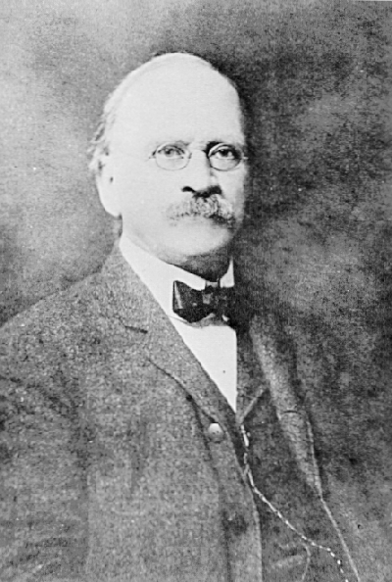
Michelson and Morley
Albert Abraham Michelson
(1852~1931)
Nobel Prize Winner (1907)
Edward Williams Morley
(1838~1923)
그림출처(좌):http://en.wikipedia.org/wiki/File:Albert_Abraham_Michelson2.jpg
(으): http://ko.wikipedia.org/wiki/%ED%8C%8C%EC%9D%BC:Edward_Williams_Morley.jpg

Slide 10
Must Watch
Michelson-Morley Experiment (1/3)
1887, Cleveland, Ohio
- When Einstein was 8
- 23 years after the Maxwell’s equations
- Michelson and Morley wanted to prove the
existence of aether by direct measurement
- Michelson measured the speed of light
most accurately

Slide 11
Michelson’s first Experiment
Michelson-Morley Experiment (2/3)
1880 in Berlin, Germany
- c= $3×{10}^{8}$m/s
- v= $3×{10}^{4}$m/s
- necessary to measure the travel time
difference of 2 light beams
of order ${\left(\frac{v}{c}\right)}^{2}={10}^{−8}$ - The instrument was not dependable enough
- No conclusion
- Stopped working on the project

Slide 12
Michelson-Morley Experiment
Michelson-Morley Experiment (2/3)
1887 Clevland, Ohio, USA
- Greatly improved his old interferometer
with Morley
- Tried to detect the aether, again!
- The result was in complete disagreement
with the existence of aether

Slide 13
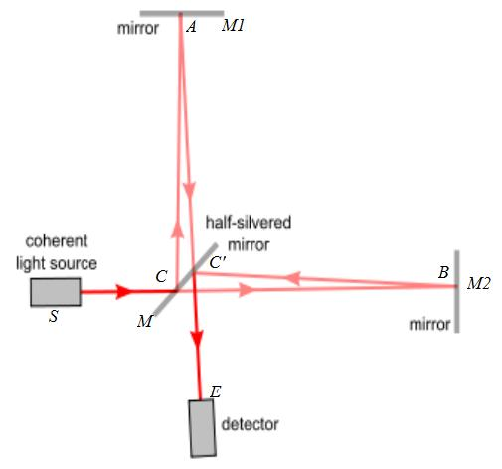
Michelson interferometer
A half-silvered act as a beam splitter.
50 % -> the mirror M1
50 % -> the mirror M2
그림출처: http://en.wikipedia.org/wiki/File:Michaelson_with_letters.jpg

Slide 14
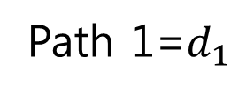
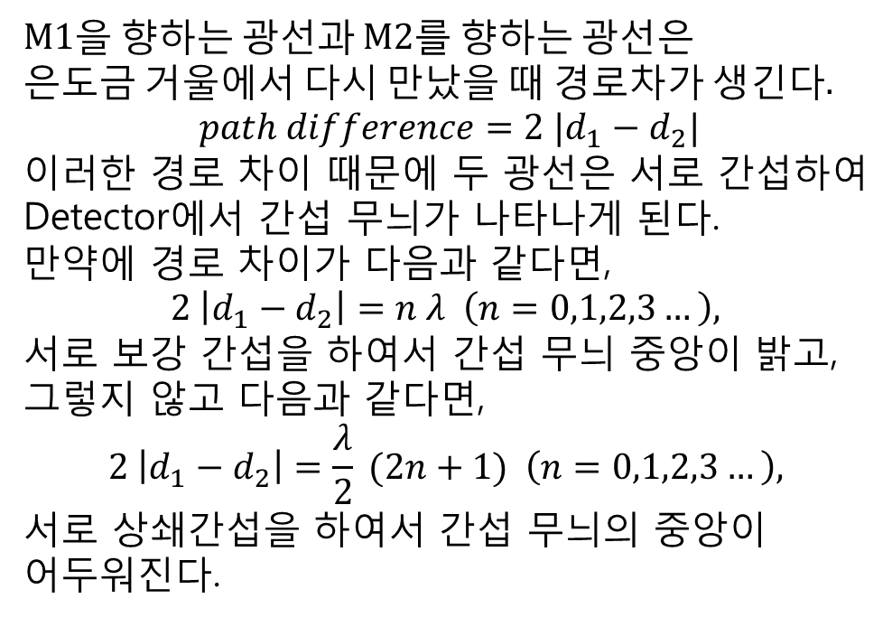
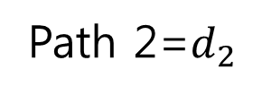
Michelson interferometer
M1을 향하는 광선과 M2를 향하는 광선은
은도금 거울에서 다시 만났을 때 경로차가 생긴다.
$$path difference=2 |d_{1}−d_{2}|$$
이러한 경로 차이 때문에 두 광선은 서로 간섭하여
Detector에서 간섭 무늬가 나타나게 된다.
만약에 경로 차이가 다음과 같다면,
$$2 \left|d_{1}−d_{2}\right|=n λ \left(n=0,1,2,3…\right),$$
서로 보강 간섭을 하여서 간섭 무늬 중앙이 밝고,
그렇지 않고 다음과 같다면,
$$2 \left|d_{1}−d_{2}\right|=\frac{λ}{2} (2n+1) \left(n=0,1,2,3…\right),$$
서로 상쇄간섭을 하여서 간섭 무늬의 중앙이
어두워진다.
Path 1=$d_{1}$
Path 2=$d_{2}$
그림출처: http://en.wikipedia.org/wiki/File:Michaelson_with_letters.jpg

Slide 15
Michelson-Morley Experiment
Ether wind
그림출처: http://en.wikipedia.org/wiki/File:Michaelson_with_letters.jpg
Interferometer를
돌려가면서 간섭 무늬를 확인한다.

Slide 16
Efforts to resolve theoretical dilemma

Slide 17
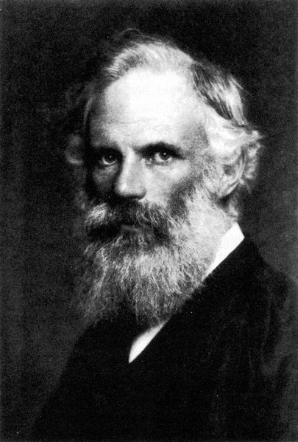
FitzGerald Contraction (1892)
Suggested modified experiment by shortening an arm of the Michelson-Morley experiment
Predicted Length contraction depending on the v(earth)
Experimentally verified later
George Francis FitzGerald (1851~1901)
그림출처: http://en.wikipedia.org/wiki/File:George_Francis_FitzGerald.jpg

Slide 18
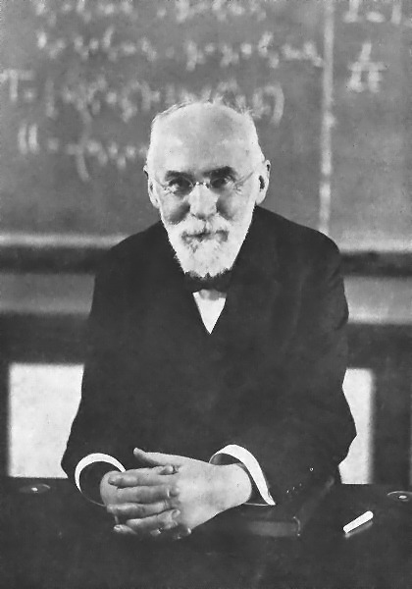
Lorentz (1895)
Michelson-Morley Experiment (3/3)
To most physicists FitzGerald’s idea was absurd.
Developed the Lorentz transformation and explained the FitzGerald contraction
Hendrik Lorentz (1853~1928)
그림출처: http://en.wikipedia.org/wiki/File:Hendrik_Antoon_Lorentz.jpg

Slide 19
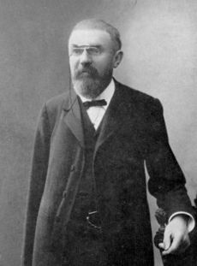
Poincaré (1899)
Offered a general explanation of the experiment
Calling it the principle of relativity
Absolute motion will never be detected
Predicted entirely new dynamics is involved that is distinguished from Galilean relativity
Henri Poincaré
(1854~1912)
그림출처: http://en.wikipedia.org/wiki/File:JH_Poincare.jpg

Slide 20
Implications of the results
Galilei’s inertia: No difference between “at rest” and motion with “$v≠0$”
If Michelson’s experiment proved the existence of aether, then it disproves the Galilei’s idea that any inertial reference systems are equivalent.

Slide 21
In Summary, Michelson-Morley Experiment was
the most brilliant failure in science history
In Summary, Michelson has done the following: 1. Measured c most accurately 2. First measurement of the diameter of a star 3. Proved that the speed of light is invariant in any inertial reference frame. However, he never accepted this.

Slide 22
References
http://galileo.phys.virginia.edu/classes/109N/lectures/michelson.html

