Slide 1
Length Contraction

Slide 2
Now we know that …
According to Michelson-Morley Experiment,
the speed of light is invariant.
One of the most remarkable consequences of the conclusion is time dilation.
There is another striking consequence called length contraction, which is equivalent to the time dilation.
Today, we derive the length contraction formula and understand its meaning.

Slide 3
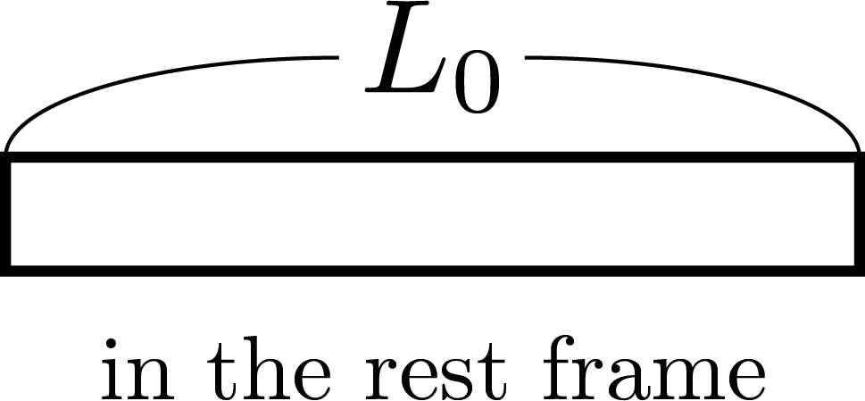
Proper Length
There are 2 rods (A and B) each
with the proper length $L0$ .
Proper length is the length of the rod measured in its rest frame.

Slide 4
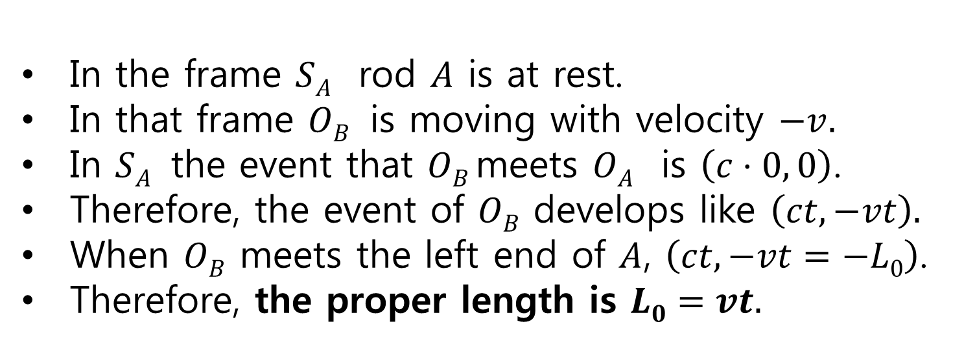
Measuring Proper Length of A
In the frame $SA$ rod $A$ is at rest.
In that frame $OB$ is moving with velocity $−v.$
In $SA$ the event that $OB$meets $OA$ is $\left(c⋅0, 0\right)$.
Therefore, the event of $OB$ develops like $\left(ct, −vt\right).$
When $OB$ meets the left end of $A$, $\left(ct, −vt=−L0\right)$.
Therefore, the proper length is $L0=vt.$
$$−v$$
$$−v$$
$$OB \left(ct, −vt=−L0\right)$$
$$OB \left(c⋅0, 0\right)$$
$$A$$
$$OA$$
In the frame $SA$

Slide 5
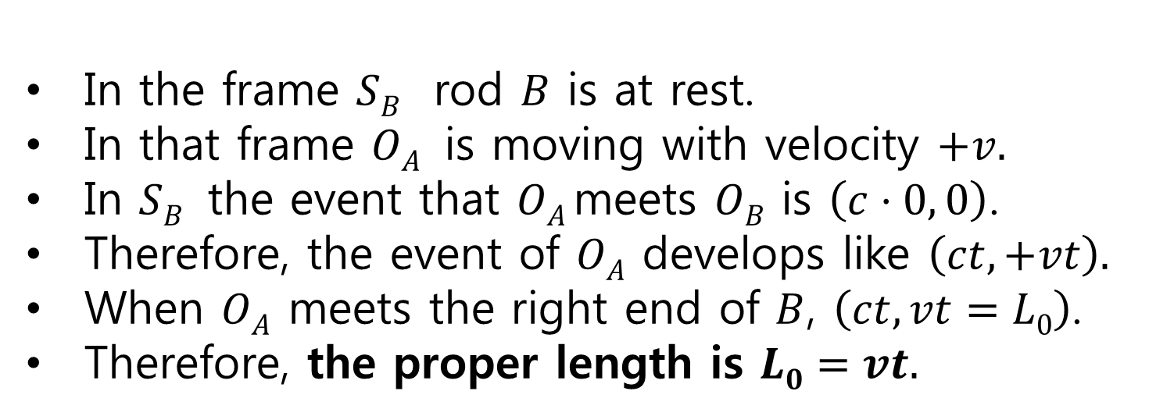
Measuring Proper Length of B
In the frame $SB$ rod $B$ is at rest.
In that frame $OA$ is moving with velocity $+v.$
In $SB$ the event that $OA$meets $OB$ is $\left(c⋅0, 0\right)$.
Therefore, the event of $OA$ develops like $\left(ct, +vt\right).$
When $OA$ meets the right end of $B$, $\left(ct, vt=L0\right)$.
Therefore, the proper length is $L0=vt.$
$$+v$$
$$+v$$
$$OA \left(c⋅0, 0\right)$$
$$OA \left(ct, vt=L0\right)$$
$$B$$
$$OB$$
In the frame $SB$

Slide 6
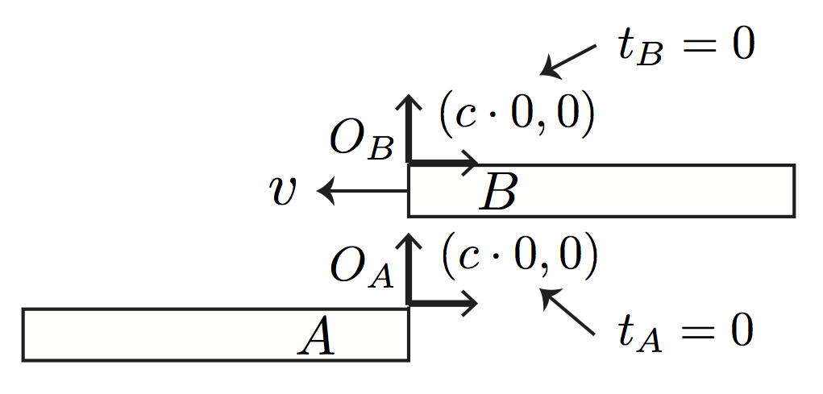
Two rods in relative motion
They move with the relative speed $v$.
- To A, B is moving to the right
- To B, A is moving to the left
$SA$is the frame fixed at A whose origin is $OA$ that is on the right end of A
$SB$is the frame fixed at B whose origin is $OB$that is on the left end of B
When $OA$and$OB$meet, we synchronize
the clocks as $tA=t_{B}=0.$

Slide 7
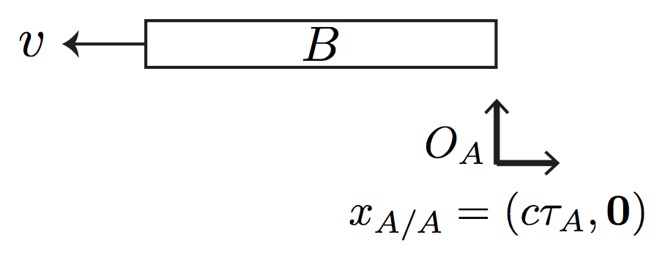
Length of moving rod B
Recall that $OA$ met the left end of $B$at $t_{A}=0.$
Suppose $OA$ meet the right end of $B$at $t_{A}=τA.$
It took the time $τA$ for the rod $B$ to pass $OA$
Recall that the rod move with the speed $v$.
Now we can compute the length of the moving rod $B$ as $LB\left(v\right)=vτA$.

Slide 8
Length of moving rod A
Recall that $OB$ met the right end of $A$at $t_{B}=0.$
Suppose $OB$ meet the left end of $A$at $t_{B}=τB.$
It took the time $τB$ for the rod$A$ to pass $OB$
Recall that the rod move with the speed $v$.
Now we can compute the length of the moving rod$A$ as $LA\left(v\right)=vτB$.

Slide 9
Based on the symmetry,
Because of the symmetry between A and B, $LA\left(v\right)=LB(v)$ $≡L(v)$ and, therefore, $τA=τB≡τ$.
The proper length of the rod is
$L0=vt.$
The length of the rod when moving with $v$ is
$L\left(v\right)=vτ$.
According to time dilation, $t=γτ.$
Therefore,
$L\left(v\right)=vτ=\frac{vt}{γ}=\frac{L0}{γ}$ < $L0$
This is called length contraction!

Slide 10
Prelude of Einstein’s Theory II - The Findings of Henry Lorentz
1/3 discussion of simultaneity
2/3 Lorentz transformation and difference between Lorentz and Einstein
3/3

Slide 11
Interesting Paradoxes on Time Dilation & Length Contraction

Slide 12
Twin Paradox

Slide 13
Twin Paradox
"If we placed a living organism in a box ... one could arrange that the organism, after any arbitrary lengthy flight, could be returned to its original spot in a scarcely altered condition, while corresponding organisms which had remained in their original positions had already long since given way to new generations. For the moving organism, the lengthy time of the journey was a mere instant, provided the motion took place with approximately the speed of light."
출처 Einstein’s 1911 paper

Slide 14
Twin Paradox
If the stationary organism is a man and the traveling one is his twin, then the traveler returns home to find his twin brother much aged compared to himself. The paradox centers around the contention that, in relativity, either twin could regard the other as the traveler, in which case each should find the other younger—a logical contradiction. This contention assumes that the twins' situations are symmetrical and interchangeable, an assumption that is not correct. Furthermore, the accessible experiments have been done and support Einstein's prediction. ...
출처 Resnick, Robert (1968). "Supplementary Topic B: The Twin Paradox". Introduction to Special Relativity. place:New York: John Wiley & Sons, Inc.. p. 201.

Slide 15
Twin Paradox
A video
Explain the reason why people called this a paradox.
Explain the reason why this is actually not a paradox. What is the difference between the two that breaks the symmetry of relativity in this problem?
출처 Resnick, Robert (1968). "Supplementary Topic B: The Twin Paradox". Introduction to Special Relativity. place:New York: John Wiley & Sons, Inc.. p. 201.

Slide 16
Ladder Paradox

Slide 17
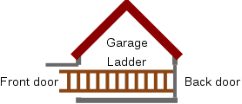
Ladder Paradox, a thought experiment
There is a ladder of length $L0$ placed horizontally.
There is a garage of length $L≪L0$.
If they are relatively at rest, the ladder does not fit into the garage.
그림출처 http://en.wikipedia.org/wiki/File:Ladder_Paradox_Overview.svg

Slide 18
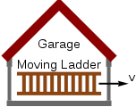
Ladder moving into the garage
If the ladder moves with $v$ >$\frac{\sqrt{γ^{2}−1}}{γ}c,$ where $γ≡\frac{L0}{L},$the ladder fits into the garage to an observer at rest at the garage.
그림출처: http://en.wikipedia.org/wiki/File:Ladder_Paradox_GarageFrame.svg

Slide 19
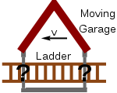
Ladder Paradox
To an observer placed at the ladder, garage must contract to prohibit the ladder from fitting into the garage.
This is called the ladder paradox.
그림출처: http://en.wikipedia.org/wiki/File:Ladder_Paradox_GarageFrame.svg

Slide 20
It is actually not a paradox
The problem is resolved by applying the relativity of simultaneity correctly.
You will be able to solve the problem with ease after we learn the Lorentz transformation.

