Slide 1
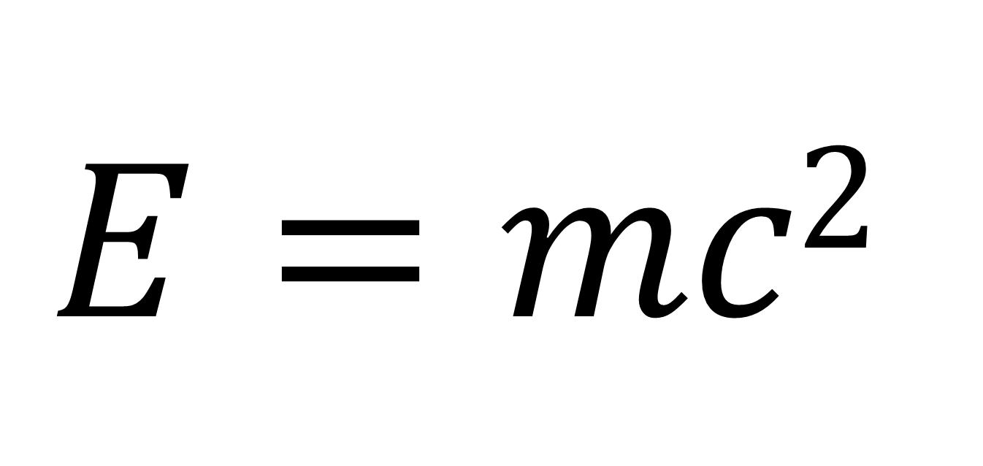
$$E=mc2$$
2012. 4. 4
이정일

Slide 2
Kinetic Energy

Slide 3
Difference between $\vec{v}≠0$ and $\vec{v}=0$
$\vec{v}=$constant and $\vec{v}=0$: equivalent under Galilean transform
What should we do to make something at rest move with $\vec{v}$?
We define the kinetic energy $T$ to be the amount of energy to make something move.
Define $T(\vec{v}=\vec{0})≡0.$

Slide 4
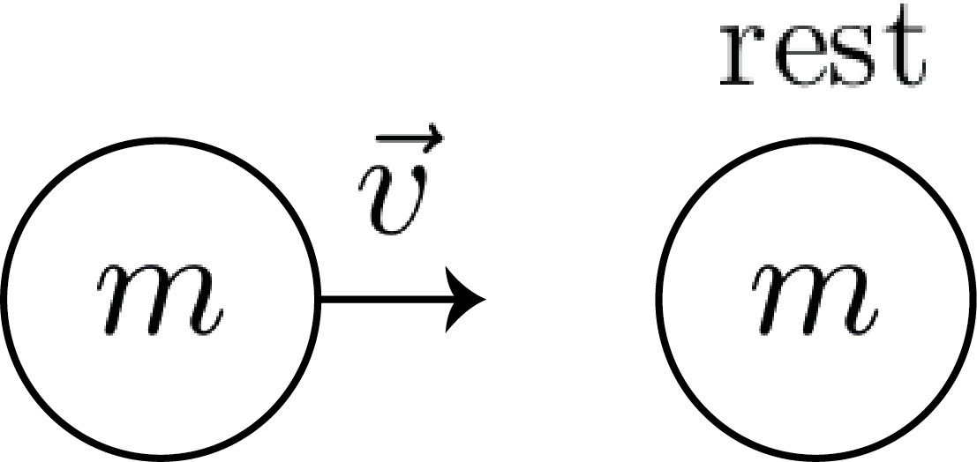
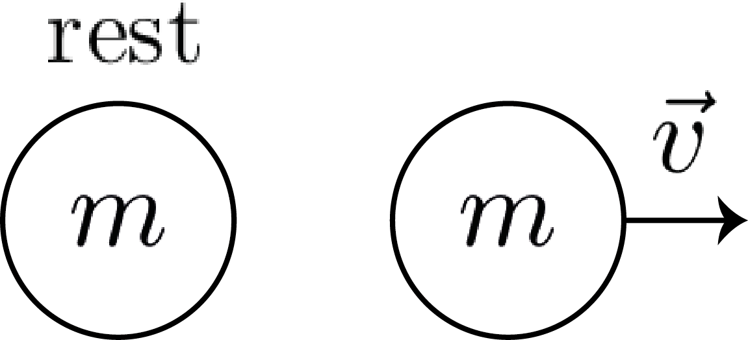
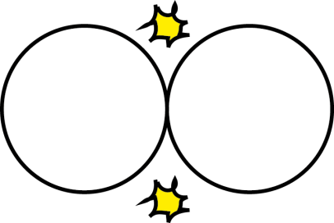
Example
Velocity exchange in an elastic collision of identical particles:
video
Newton’s laws of motion (3rd) explains the momentum conservation:
$${\vec{p}}_{before}={\vec{p}}_{after}=m\vec{v}+m\vec{0}=m\vec{v}$$

Slide 5
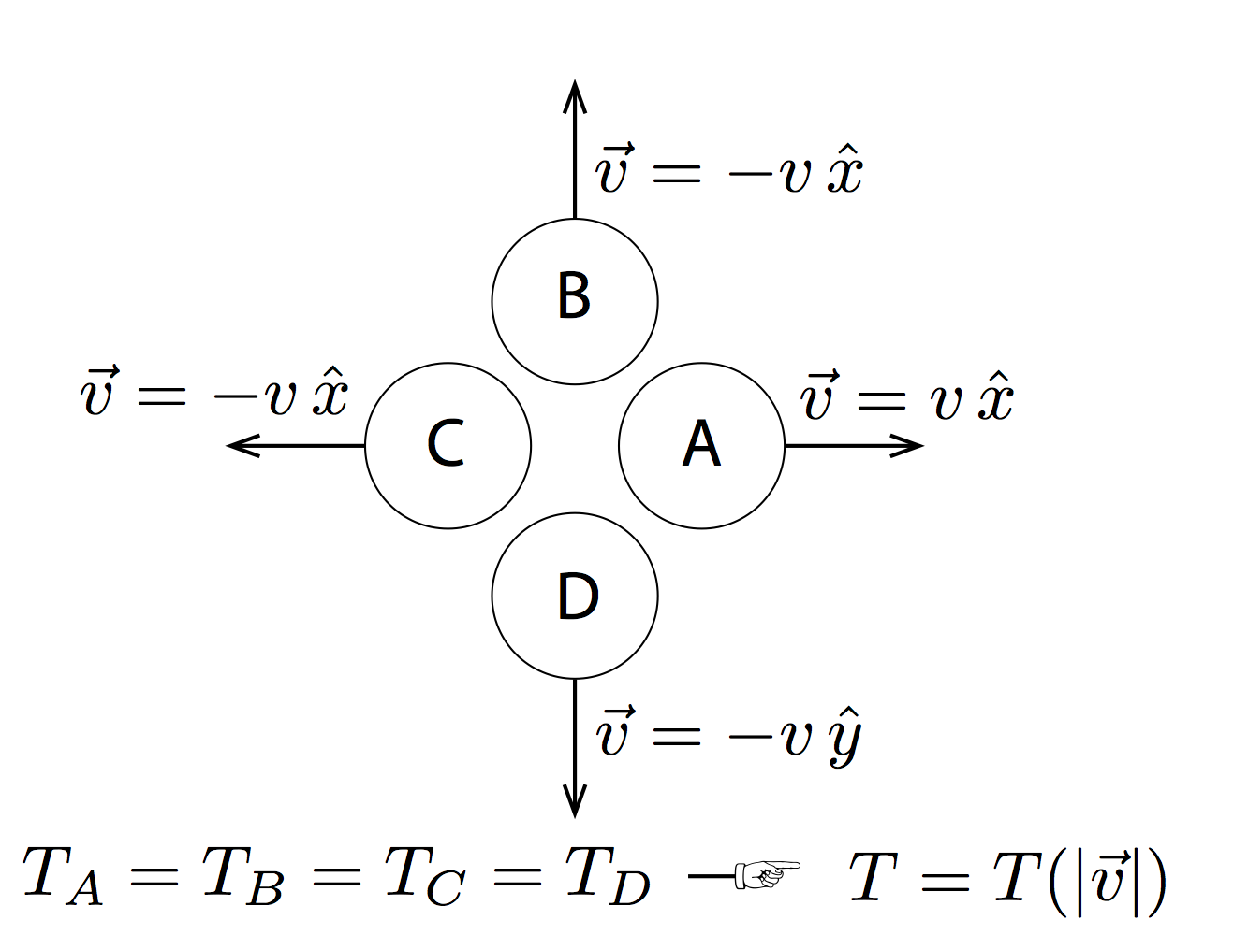
We assume..
K.E. $T$ depends on $|\vec{v}|$.
K.E. $T$ is independent of the direction.

Slide 6
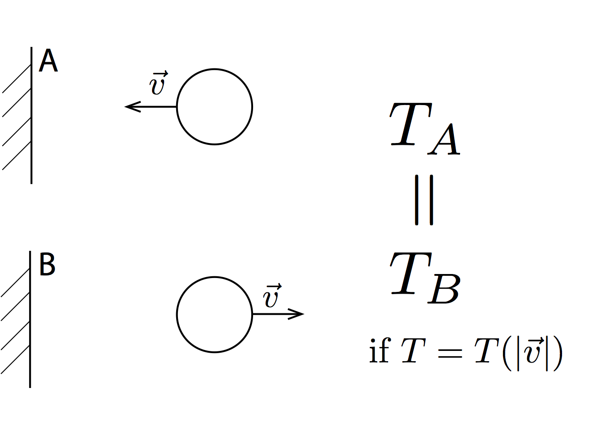
Bouncing a ball
K.E. is conserved in this interaction!
video

Slide 7
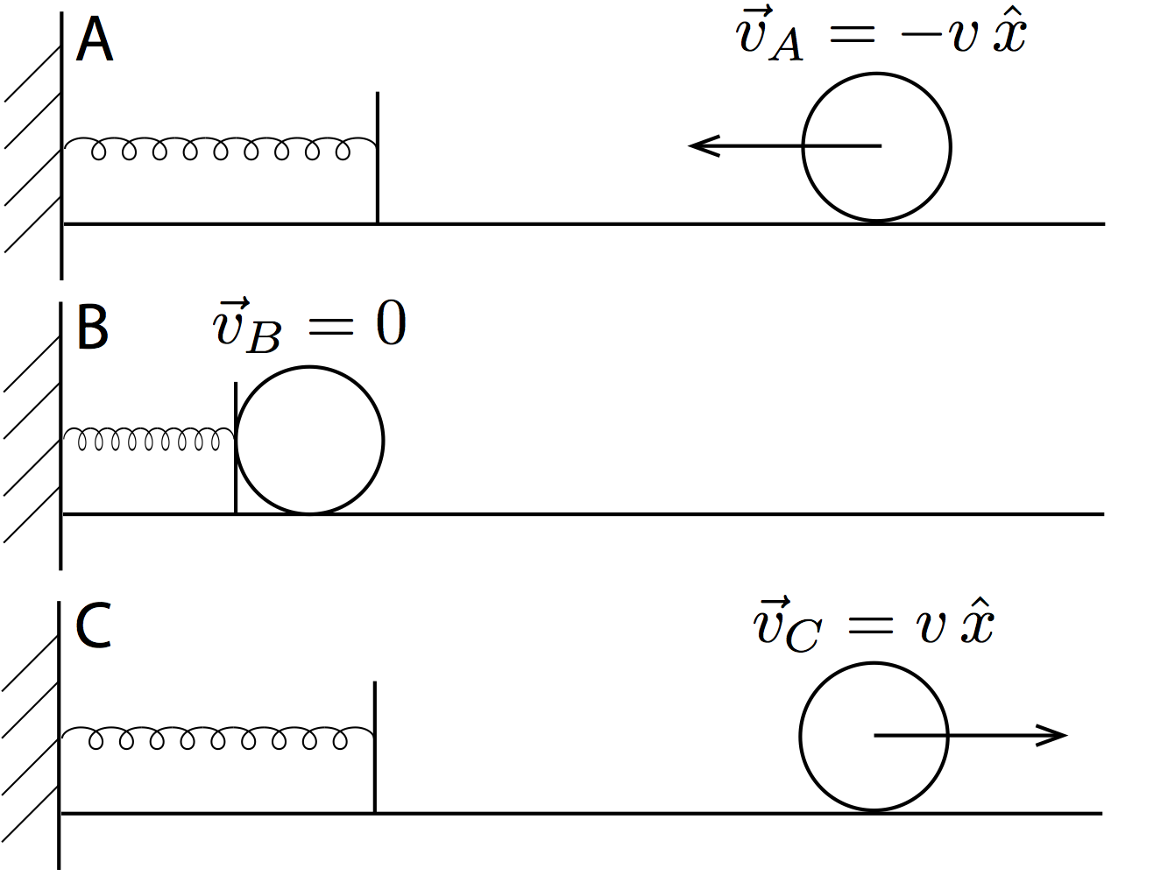
Bounce against a spring
$T_{A}=T_{C}$: conserved
However, $T_{B}=0.$ $T$ is not conserved!
What is the problem in this logic?

Slide 8
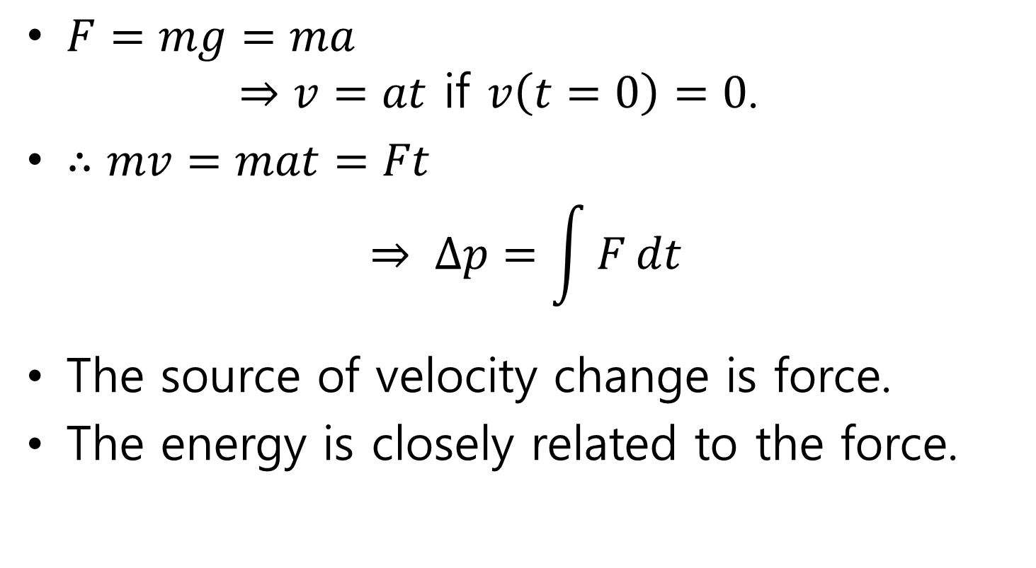
Free Fall and Acceleration
$F=mg=ma$ $⇒v=at$ if $v\left(t=0\right)=0$.
$∴mv=mat=Ft$ $⇒ ∆p=\int{F}dt$
The source of velocity change is force.
The energy is closely related to the force.

Slide 9
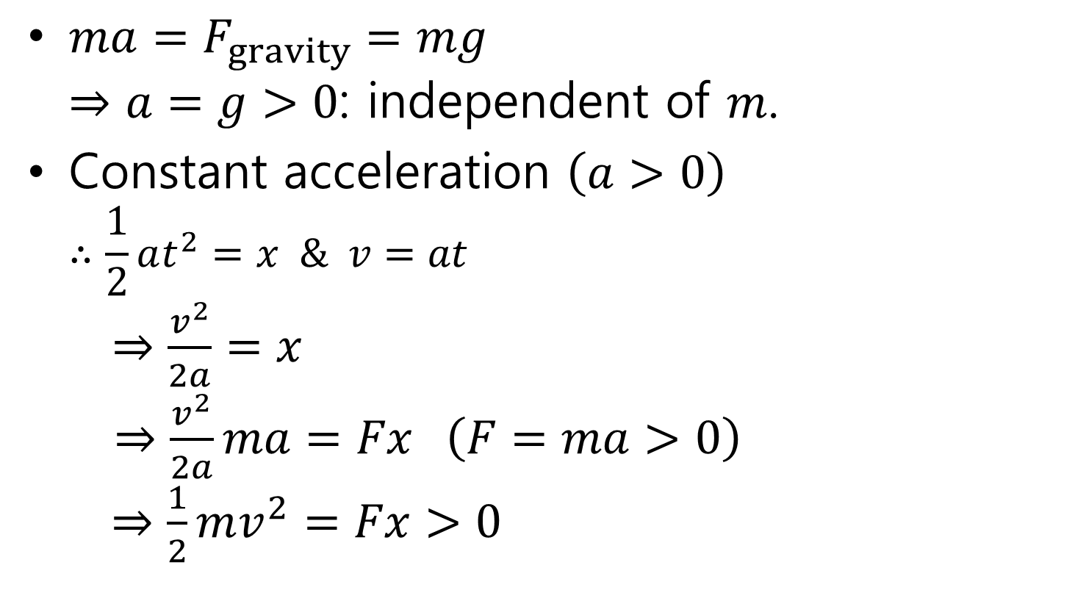
Free fall and Acceleration
$ma=F_{gravity}=mg$ $⇒a=g>0$: independent of $m$.
Constant acceleration $\left(a>0\right)$ $∴\frac{1}{2}at^{2}=x \& v=at$ $⇒\frac{v^{2}}{2a}=x$ $⇒\frac{v^{2}}{2a}ma=Fx \left(F=ma>0\right)$ $⇒\frac{1}{2}mv^{2}=Fx>0$

Slide 10
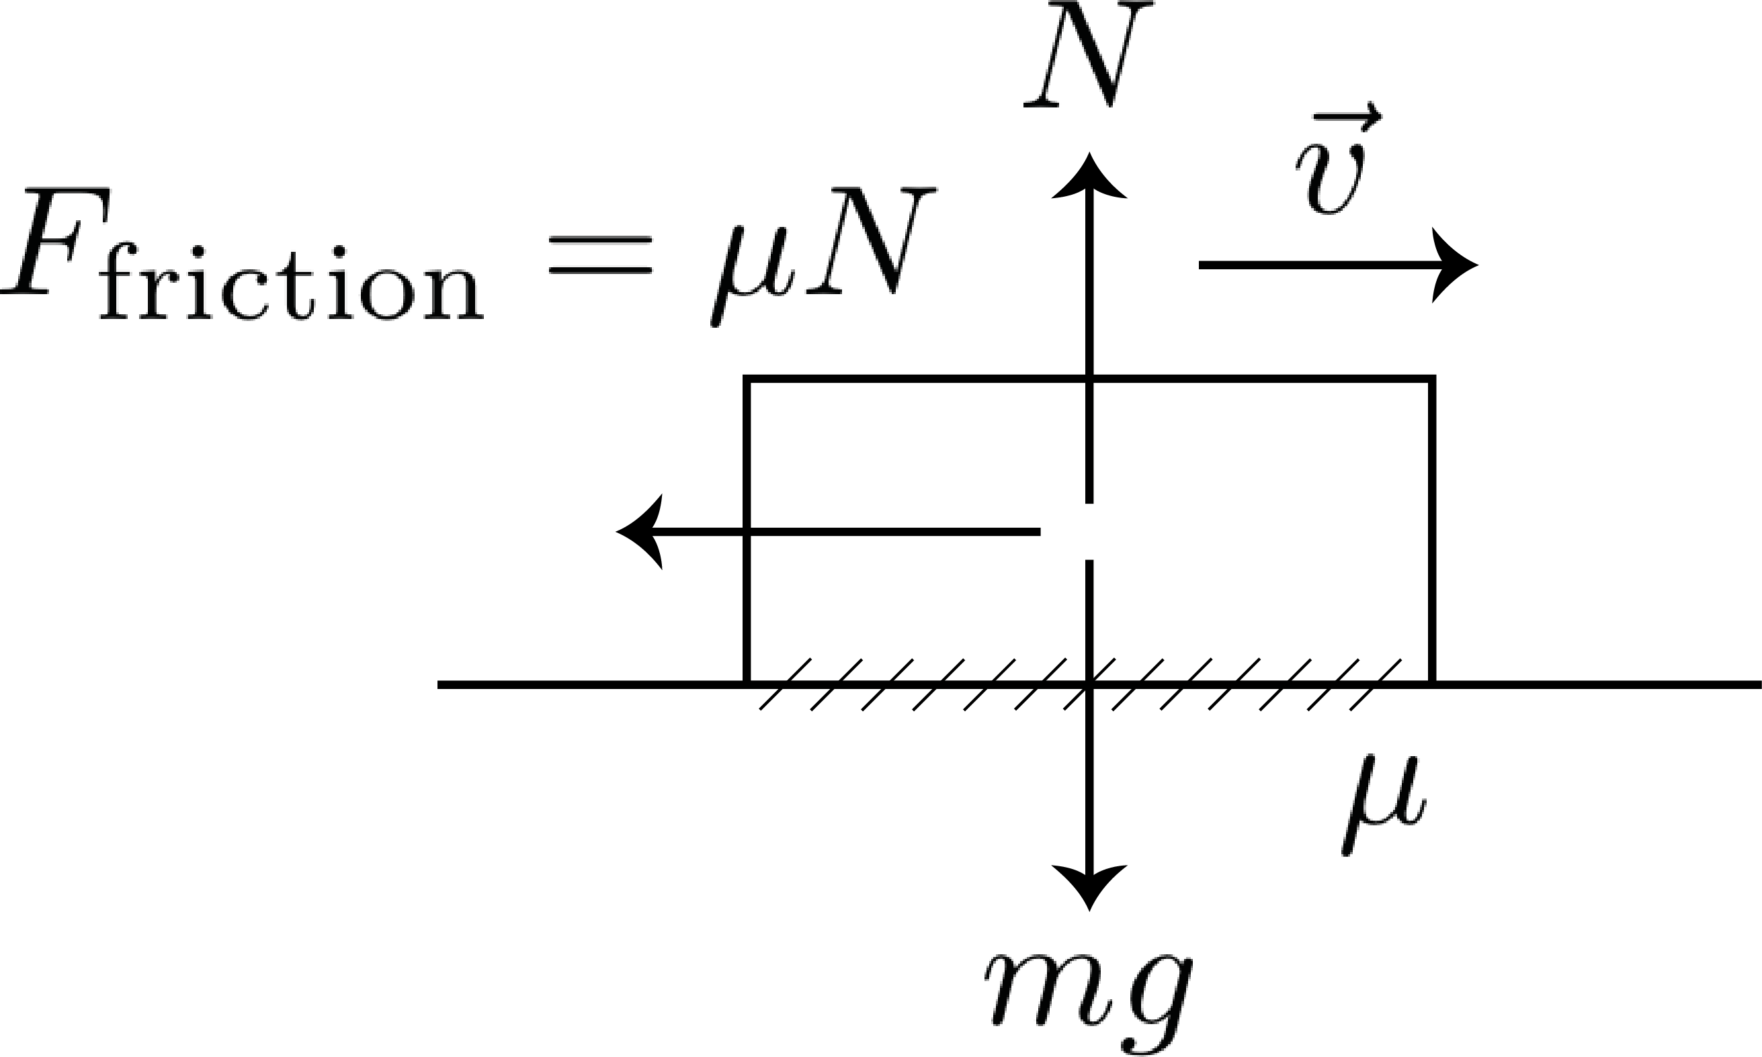
Friction and Deceleration
Friction is proportional to the normal force.
$μ$: frictional constant.
make a moving object decelerate.

Slide 11
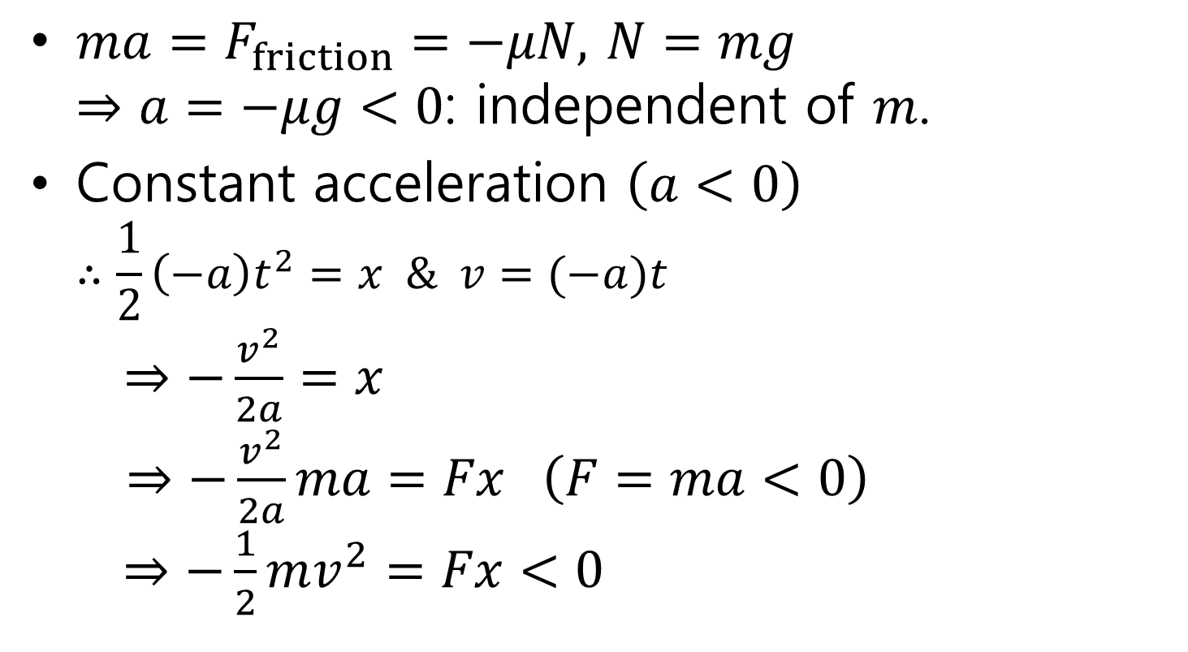
Friction and Deceleration
$ma=F_{friction}=−μN,$ $N=mg$ $⇒a=−μg<0$: independent of $m$.
Constant acceleration $\left(a<0\right)$ $∴\frac{1}{2}\left(−a\right)t^{2}=x \& v=(−a)t$ $⇒−\frac{v^{2}}{2a}=x$ $⇒−\frac{v^{2}}{2a}ma=Fx \left(F=ma<0\right)$ $⇒−\frac{1}{2}mv^{2}=Fx<0$

Slide 12
Important Results
Stopping distance $x$ is proportional to $v^{2}$, which is independent of the direction.
$∆T>0$ if $F$//$x$ $∆T<0$ if $F$//$(-x)$
Educated guess:
$$∆T≟∆\left(\frac{1}{2}mv^{2}\right)=\int{Fdx}$$

