Slide 1
Time Dilation

Slide 2
Now we know that …
According to Michelson-Morley Experiment,
the speed of light is invariant.
One of the most remarkable consequences of the conclusion is time dilation.
Today, we derive the time dilation formula.
preview 1, preview 2
Cal tech lecture
Time Dilation 1/3(5:40-), 2/3, 3/3

Slide 3
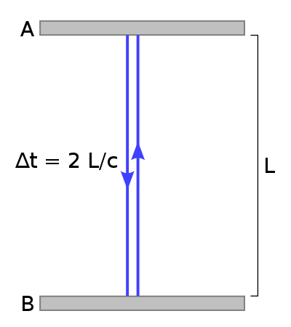
Simple Light Clock
A is a mirror
Light travels along the path B→A→B.
L : distance between
A and B.
c : the speed of light
Time(B→A): L/c
Time(A→B): L/c
(round trip)
그림출처: http://en.wikipedia.org/wiki/File:Time-dilation-001.svg

Slide 4
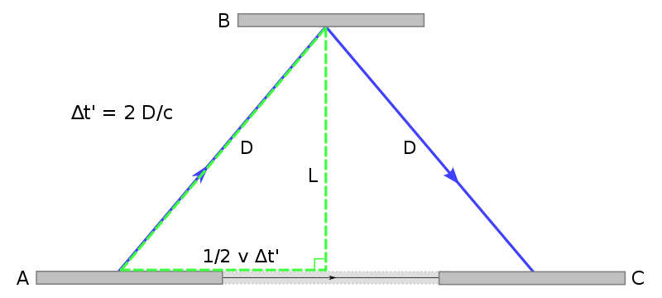
Changing the observer
We look at the same situation but we move to the left with the relative speed .
Then the light travels along a longer path .
그림출처: http://en.wikipedia.org/wiki/File:Time-dilation-002.svg

Slide 5
Why time must be dilated
Our constraint is .
Because if , then the speed of light c’ must be bigger than c.
Therefore, Δt’ > Δt: time dilation!
그림출처: http://en.wikipedia.org/wiki/File:Time-dilation-002.svg

Slide 6
How much the time dilates?
Substituting and into , we find
Because time must flow forward, the unique solution is , where
그림출처: http://en.wikipedia.org/wiki/File:Time-dilation-002.svg

Slide 7
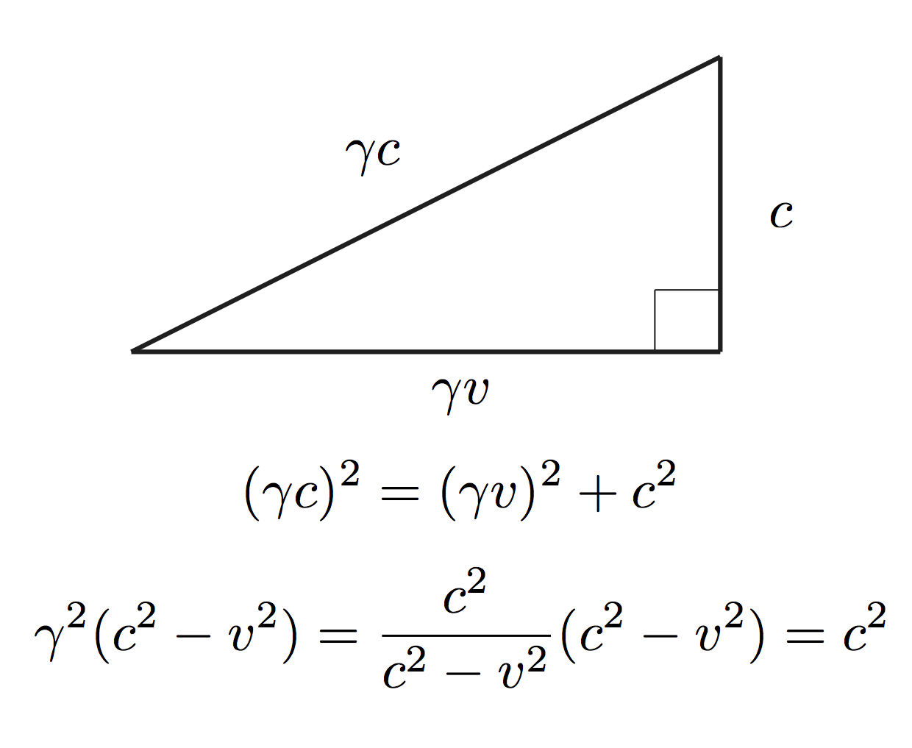
The relation among c, v, and
그림출처: http://en.wikipedia.org/wiki/File:Time-dilation-002.svg

Slide 8
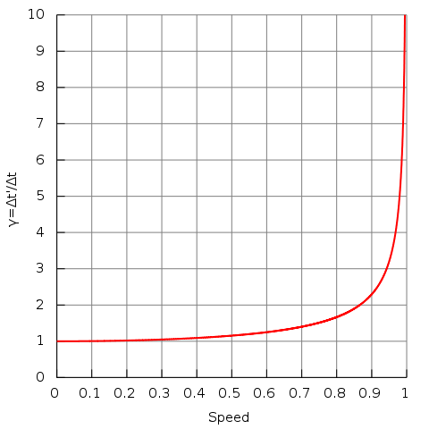

Velocity dependence of gamma
1.005 at $v=0.1 c$
1.155 at $v=0.5 c$
2.294 at $v=0.9 c$
7.089 at $v=(1−{10}^{−2}) c$
22.37 at $v=(1−{10}^{−3}) c$
70.71 at $v=(1−{10}^{−4}) c$
223.6 at $v=(1−{10}^{−5}) c$
707.1 at $v=(1−{10}^{−6}) c$
2236. at $v=(1−{10}^{−7}) c$
그림출처: http://en.wikipedia.org/wiki/File:Time_dilation.svg

Slide 9
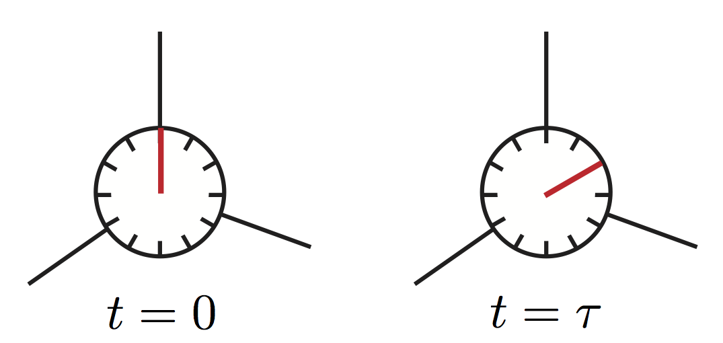
Proper Time τ (tau)
Proper time is the time indicated by a clock that is fixed at the origin of an inertial reference frame.
Proper time is the shortest time that can be measured by an observer because
and .
See the right figure.
origin

Slide 10
Event as a Four Vector
Event x=(ct, x, y, z) represents the space time point of a physical event.
- c : the speed of light
- t : the time
- x, y, and z: spatial coordinates of the event
The space-time point (event) of the clock fixed at the origin O of a frame S develops like
x=(cτ, 0, 0, 0)
when τ=0, the light leaves B
when τ=t, the light returns to B

Slide 11
Experiments confirming Time Dilation

Slide 12
촛불이 꺼지는 시간
한 시간에 다 타버리는 동일한 촛불 A와 B가
있다.
촛불 A와 B는 각각 S_{A}와 S_{B}의 원점 O_{A}와 O_{B}에 있다.
S_{A}와 S_{B}는 t_{A}=t_{B}=0일 때 일치한다.
S_{B}는 S_{A}에 대해 으로 운동한다.
O_{A}에서 볼 때 A와 B가 꺼지는 시간은?
O_{B}에서 볼 때 A와 B가 꺼지는 시간은?
같은 점과 다른 점을 설명하시오.

Slide 13
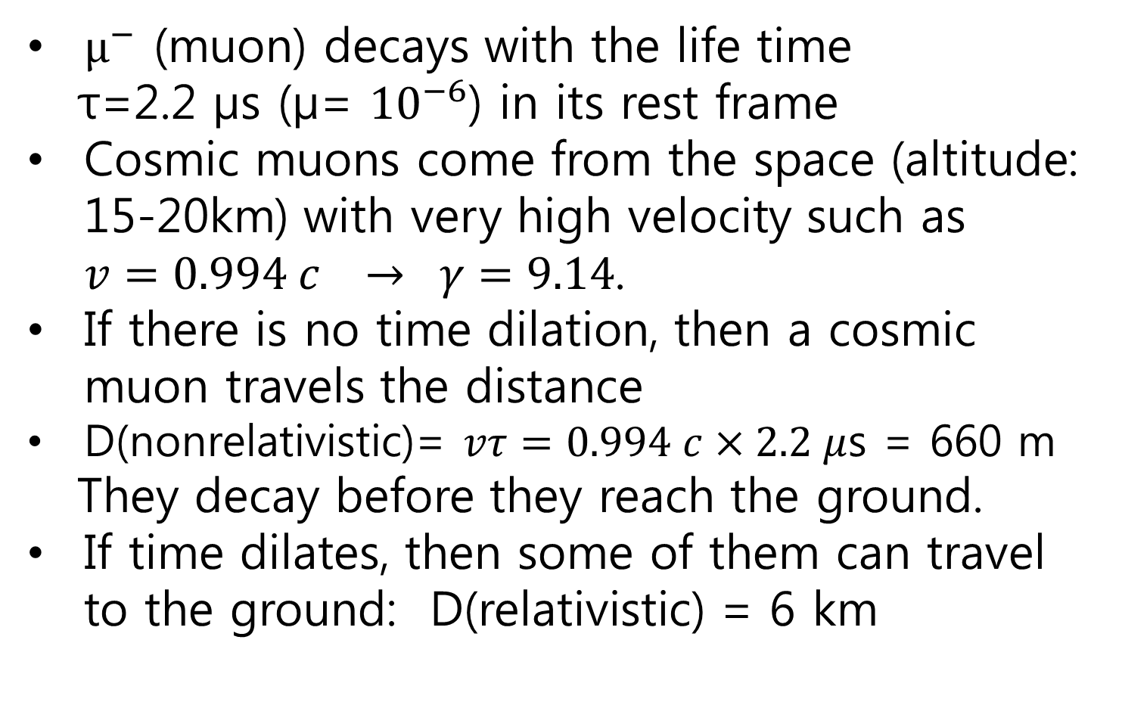
Rossi-Hall Experiment (1940)
$μ^{−}$ (muon) decays with the life time
τ=2.2 μs (μ= ${10}^{−6}$) in its rest frame
Cosmic muons come from the space (altitude: 15-20km) with very high velocity such as $v=0.994 c → γ=9.14$.
If there is no time dilation, then a cosmic muon travels the distance
D(nonrelativistic)= $vτ=0.994 c×2.2 μ$s = 660 m
They decay before they reach the ground.
If time dilates, then some of them can travel to the ground: D(relativistic) = 6 km
그림출처: http://en.wikipedia.org/wiki/File:FrischSmith.svg

Slide 14
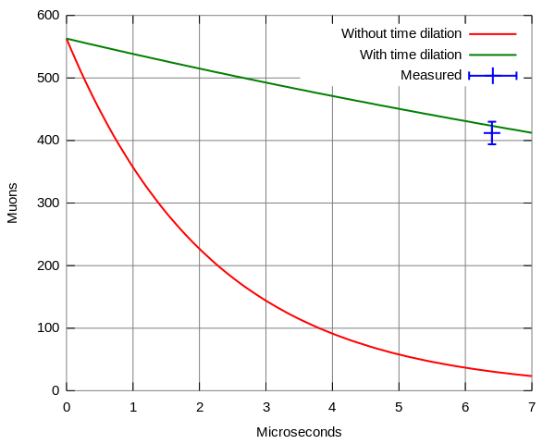
Rossi-Hall Experiment (1940)
B. Rossi and D.B. Hall, "Variation of the Rate of Decay of Mesotrons with Momentum“, Phys. Rev. D 59, 223 (1941).
그림출처: http://en.wikipedia.org/wiki/File:FrischSmith.svg

Slide 15
Experiment with an Atomic Clock (1971)
J.C. Hafele and R. E. Keating,
Around-the-World Atomic Clocks:
Predicted Relativistic Time Gains
Science 177, 166 (1972)
A real experiment of time dilation using an atomic clock in 1971

Slide 16
Abstract
During October 1971, four cesium beam atomic clocks were flown on regularly scheduled commercial jet flights around the world twice, once eastward and once westward, to test Einstein's theory of relativity with macroscopic clocks. From the actual flight paths of each trip, the theory predicts that the flying clocks, compared with reference clocks at the U.S. Naval Observatory, should have lost 40 ± 23 nanoseconds during the eastward trip, and should have gained 275 ± 21 nanoseconds during the westward trip. The observed time differences are presented in the report that follows this one.

Slide 17
GPS with an Atomic Clock (1971)
The time dilation due to Special Relativity is About 7,200 ns/day (slower)
That due to General Relativity is actually bigger: 45,900 ns/day (faster)
reference

