Slide 1
Conservation of Mechanical Energy

Slide 2
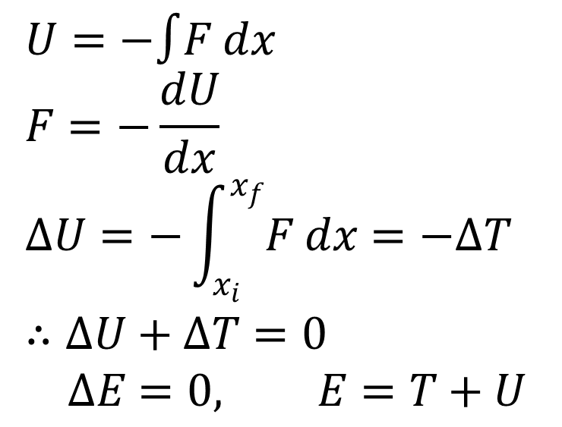
Potential Energy
$$U=−∫F dx \\ F=−\frac{dU}{dx} \\ ΔU=−\int_{x_{i}}^{x_{f}}{F dx=−ΔT} \\ ∴ΔU+ΔT=0 \\ ΔE=0, E=T+U$$
Work-K.E. theorem
(total mechanical E)
If F is a function of position x, then the total mechanical energy must be conserved. This force is called a conservative force.

Slide 3
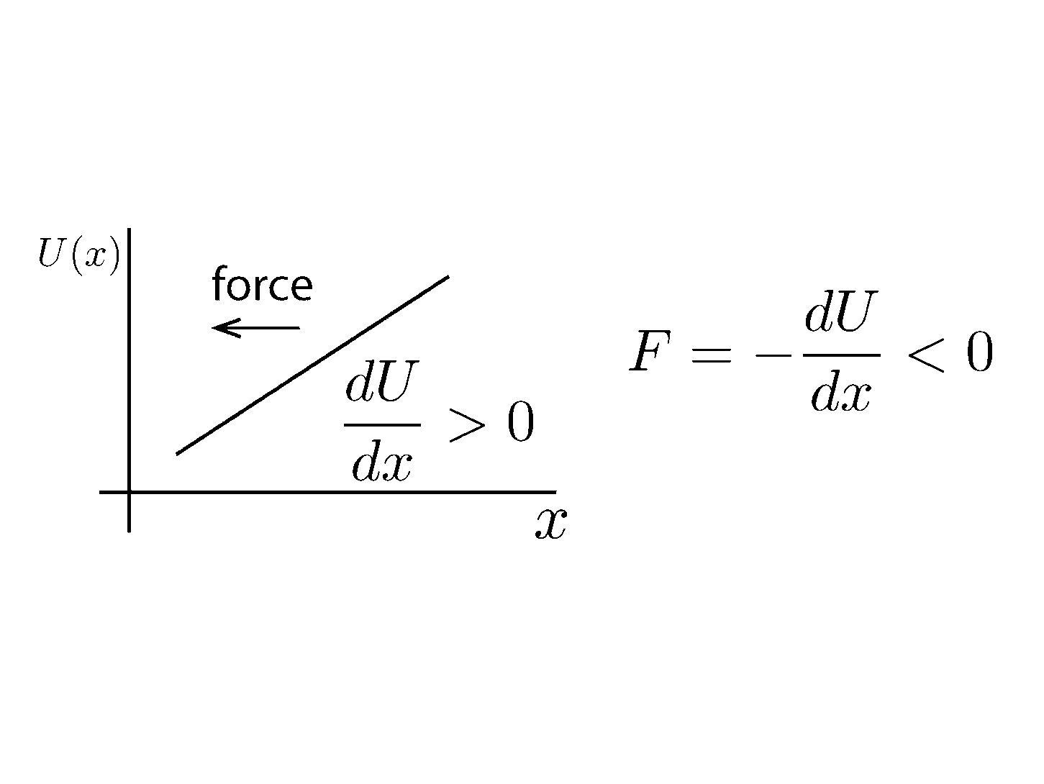
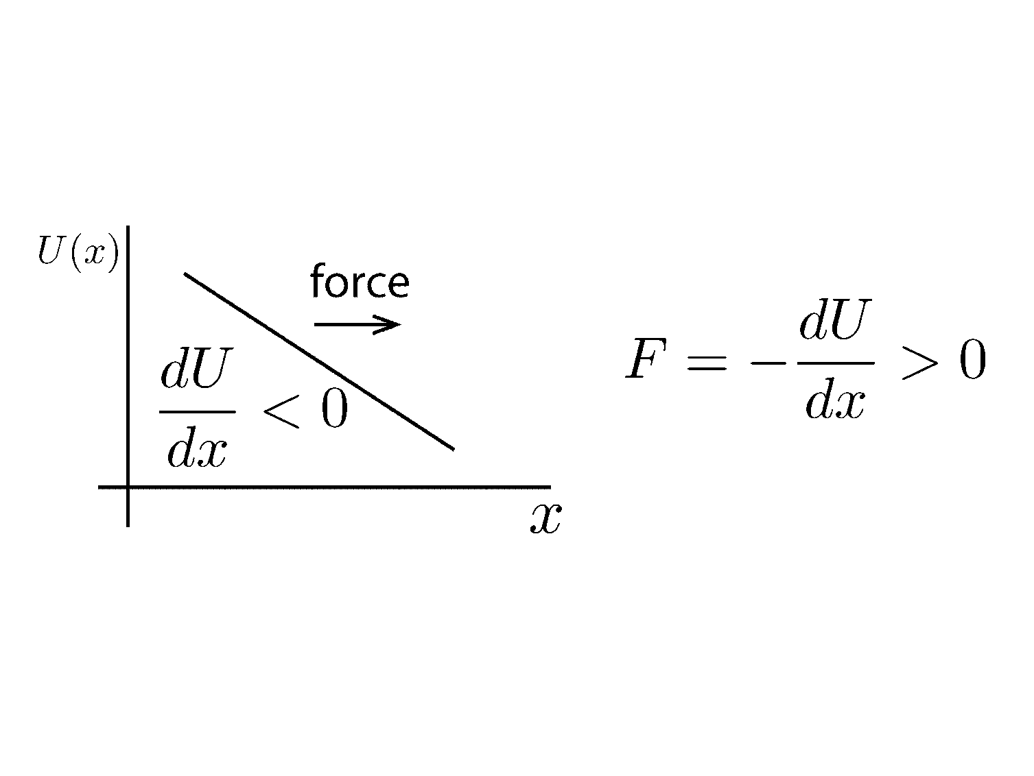
Potential Energy and Stability

Slide 4
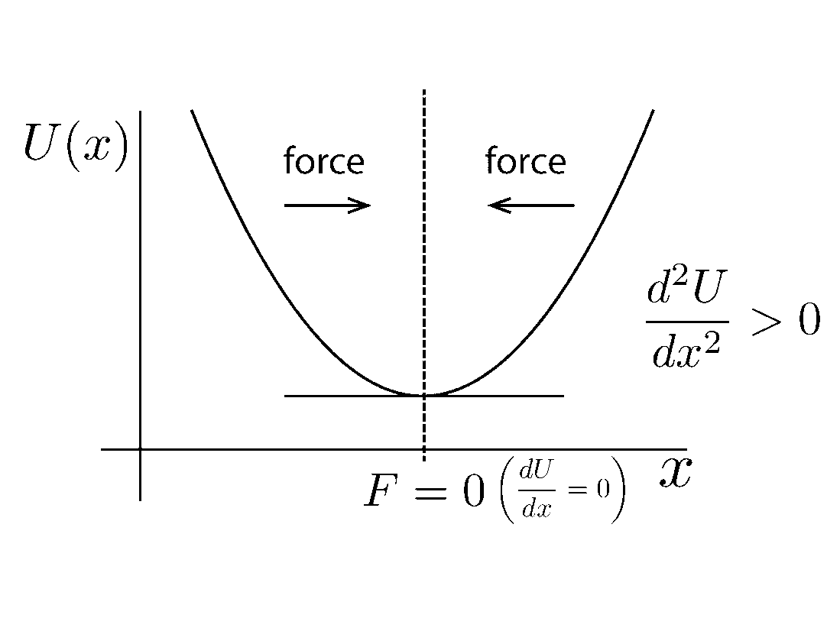
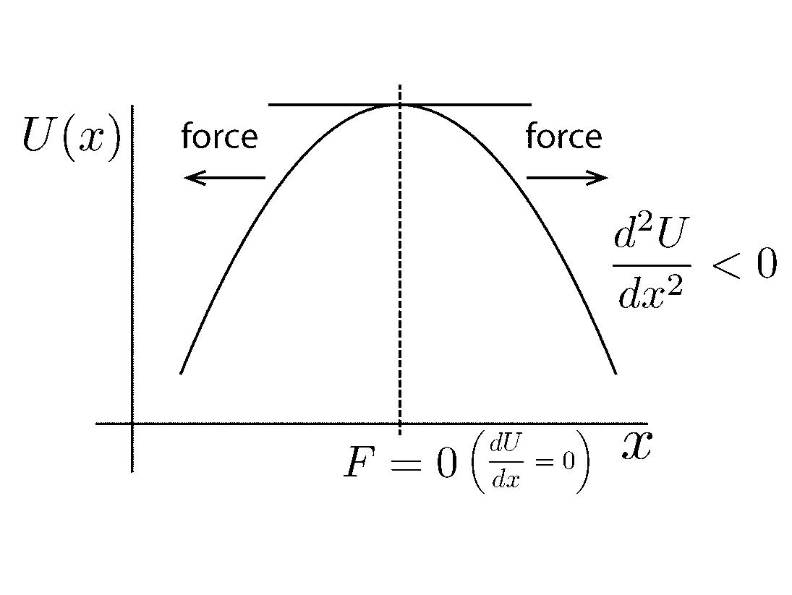
Potential Energy and Stability
stable
equilibrium
unstable
equilibrium

Slide 5
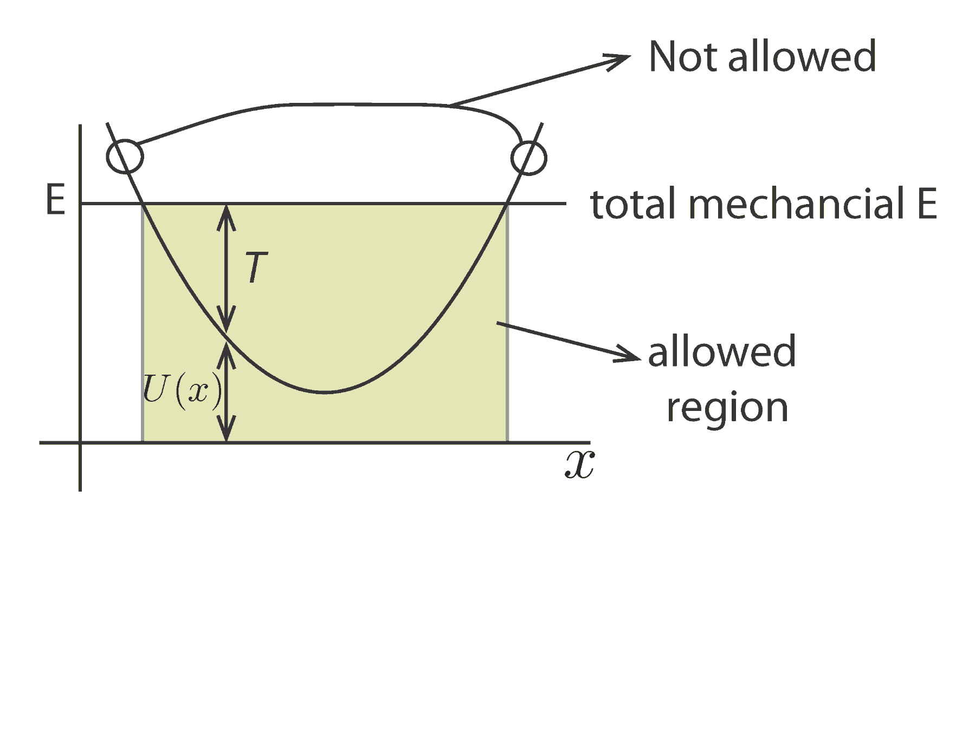
Turning Points
U>E T<0
U>E, T<0
(U<E, T>0)
$$E=U+T \\ T=E−U=\frac{1}{2}mv^{2}≥0$$
Therefore, $E≥U$.

Slide 6
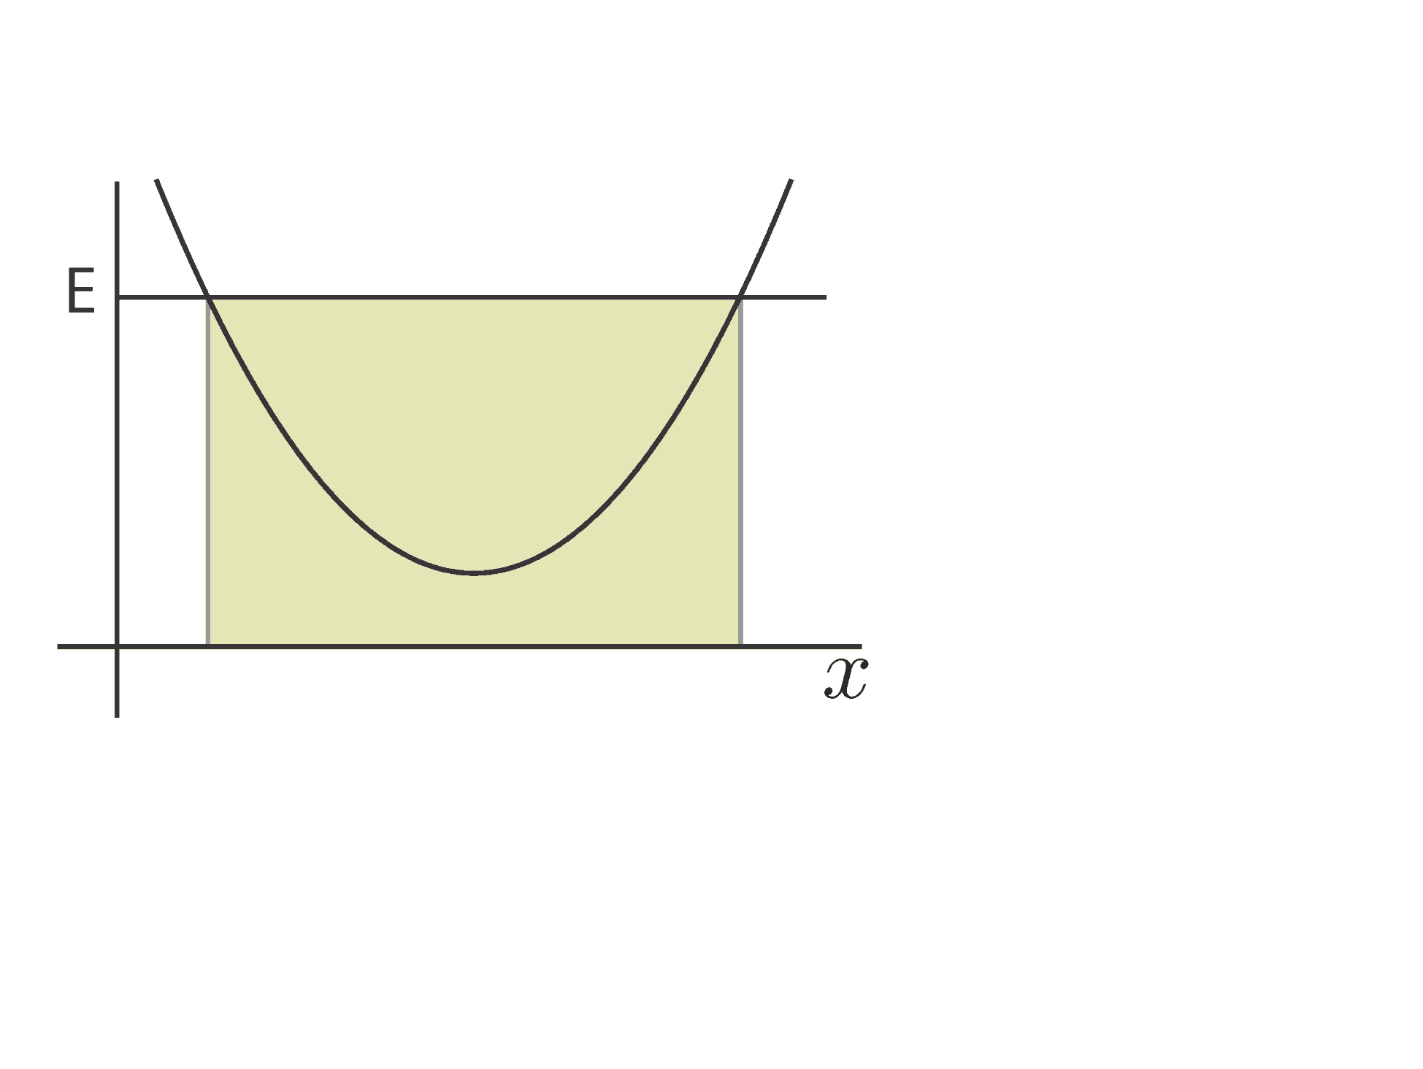
Turning Points
U(x)
$$E=U (T=0)$$
When $E=U$, $T=0$ and the object stops. If F is toward the allowed region, then the object makes a turn. This is called the turning point.

Slide 7
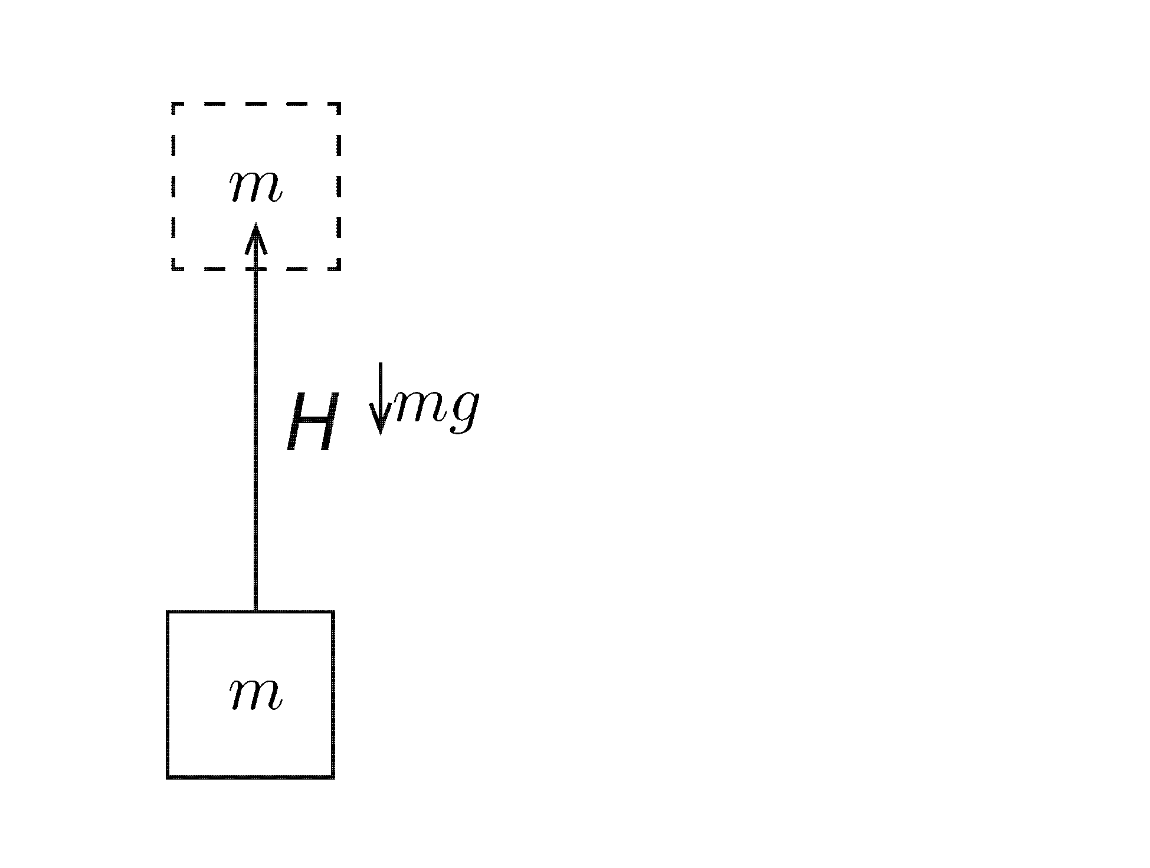

$$U_{g}=mgH$$
$$U=−∫\vec{F}⋅d\vec{x} \\ =−\left(−mg\right)H \\ =mgH$$

Slide 8
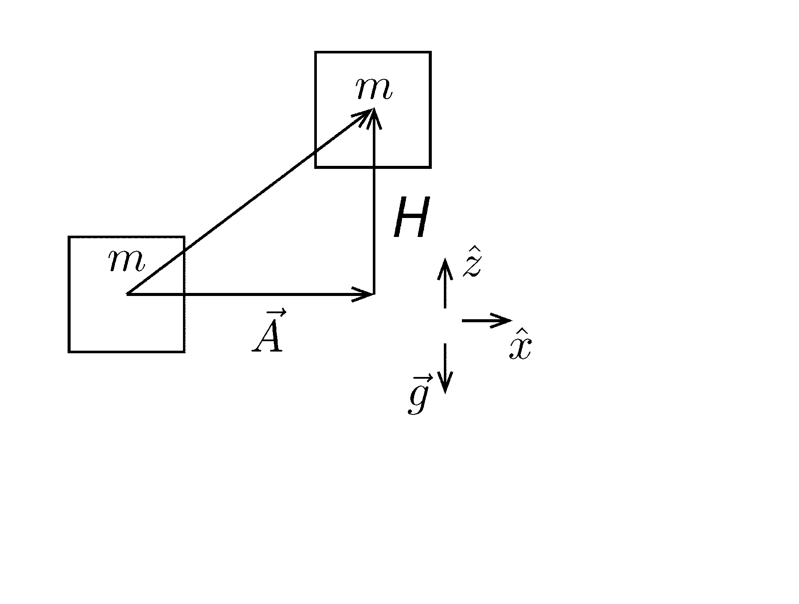

Modification
$$U=−∫{\vec{F}}_{g}⋅d\vec{x} \\ =−\left(−mg\hat{z}\right)⋅H\hat{z} \\ [ \hat{z}⋅\hat{x}=0, ∵{\vec{F}}_{g}⊥\vec{A}] \\ =mgH$$
Horizontal displacement does not change the potential energy, which depends only on the vertical displacement.

Slide 9
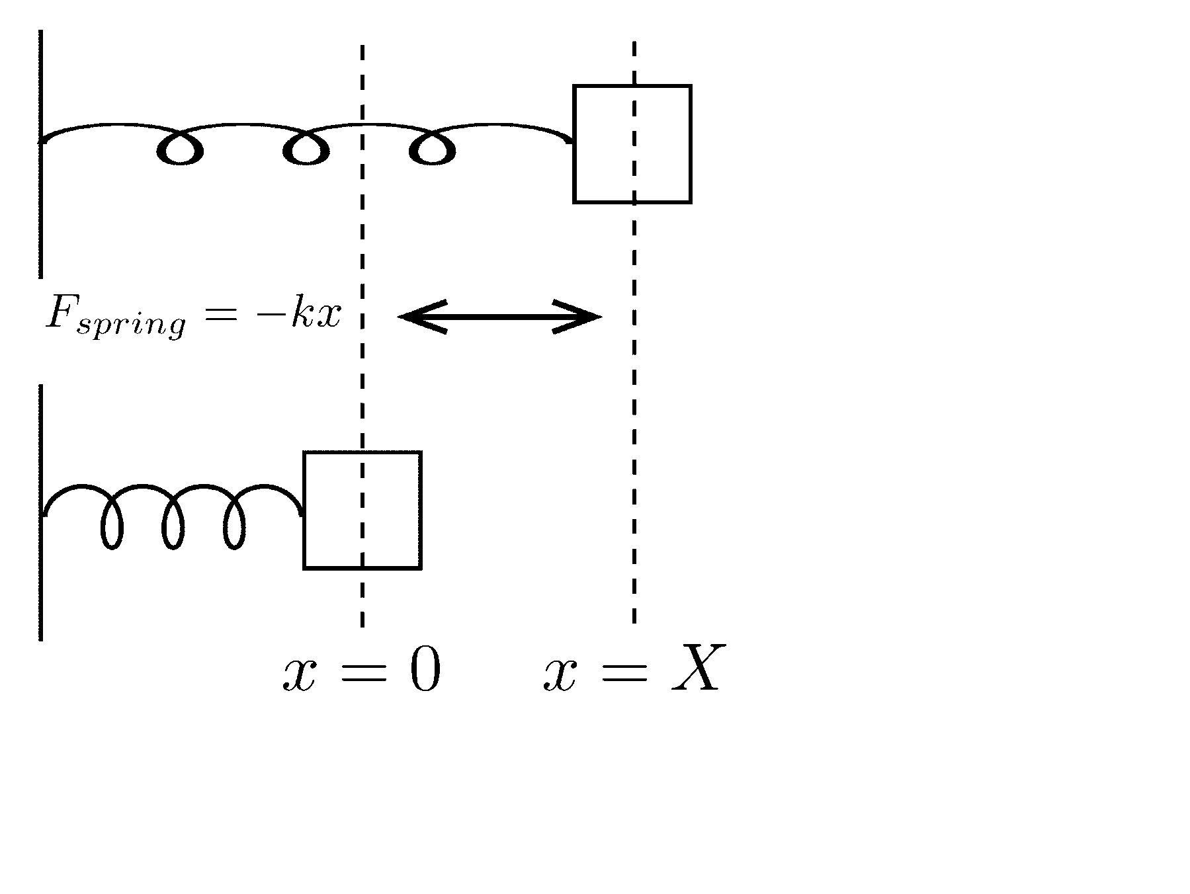

$$U_{spring}=\frac{1}{2}kx^{2}$$
$$U=−\int_{0}^{x}{F dx} \\ =−\int_{0}^{x}{\left(−kx\right)dx} \\ =\frac{1}{2}kx^{2}$$
$U\left(x=0\right)=0 i$s the simplest choice.

Slide 10
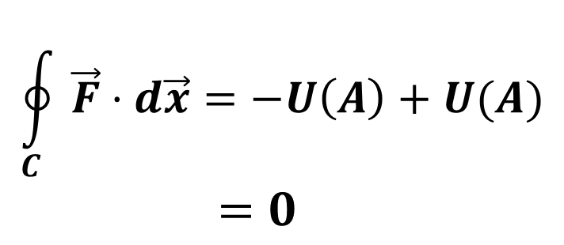
$$\oint_{C}{\vec{F}⋅d\vec{x}=0}$$
If is $\vec{F}$ conservative, then $\oint_{C}{\vec{F}⋅d\vec{x}=0}$, where c is a closed path.
$$\oint_{C}{\vec{F}⋅d\vec{x}=−U\left(A\right)+U(A)} \\ =0$$

Slide 11
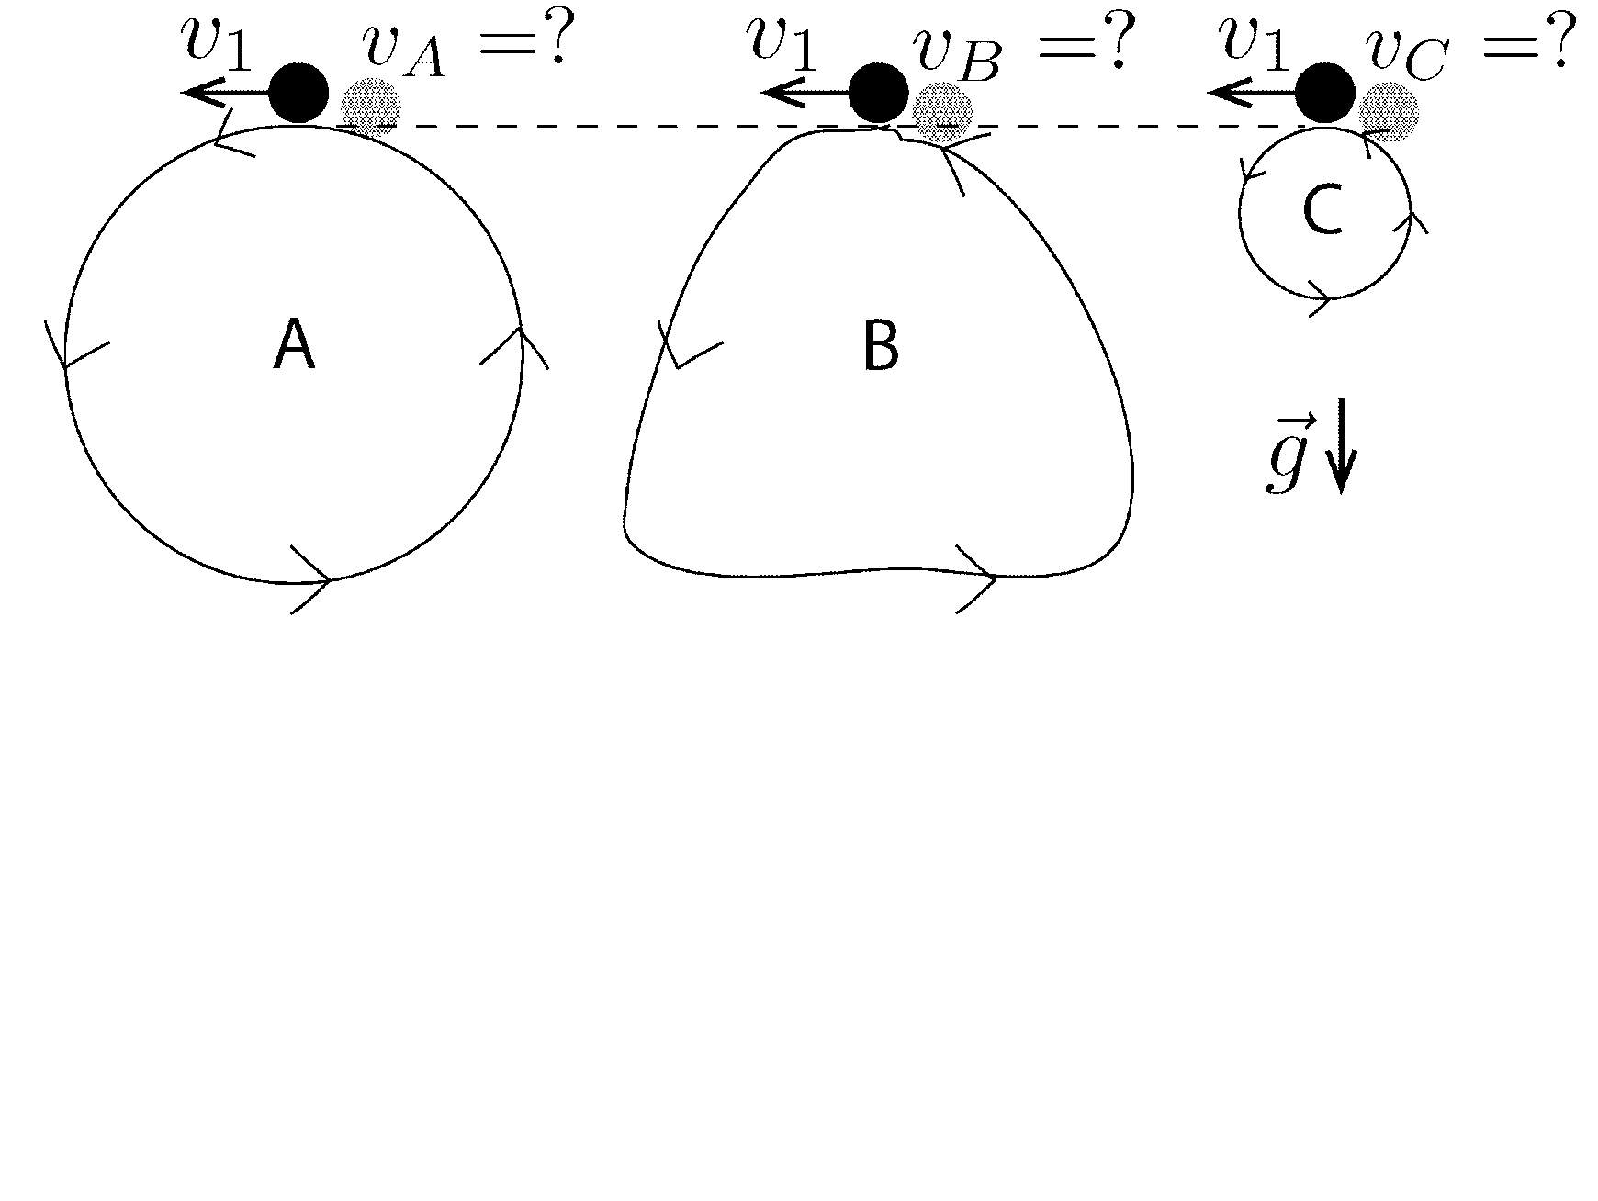

Exercise
$\oint{{\vec{F}}_{g}⋅d\vec{x}\text{ = 0} }$
${\vec{F}}_{net}={\vec{F}}_{g}+{\vec{F}}_{constraint}$ & ${\vec{F}}_{constraint}⊥d\vec{x}$
$∴\oint{{\vec{F}}_{net}⋅d\vec{x} }=\oint{{\vec{F}}_{g}⋅d\vec{x} }=0$
$ΔU=0 \& ΔE=0 → ΔT=0$
$∴v_{A}=v_{B}=v_{C}$

Slide 12
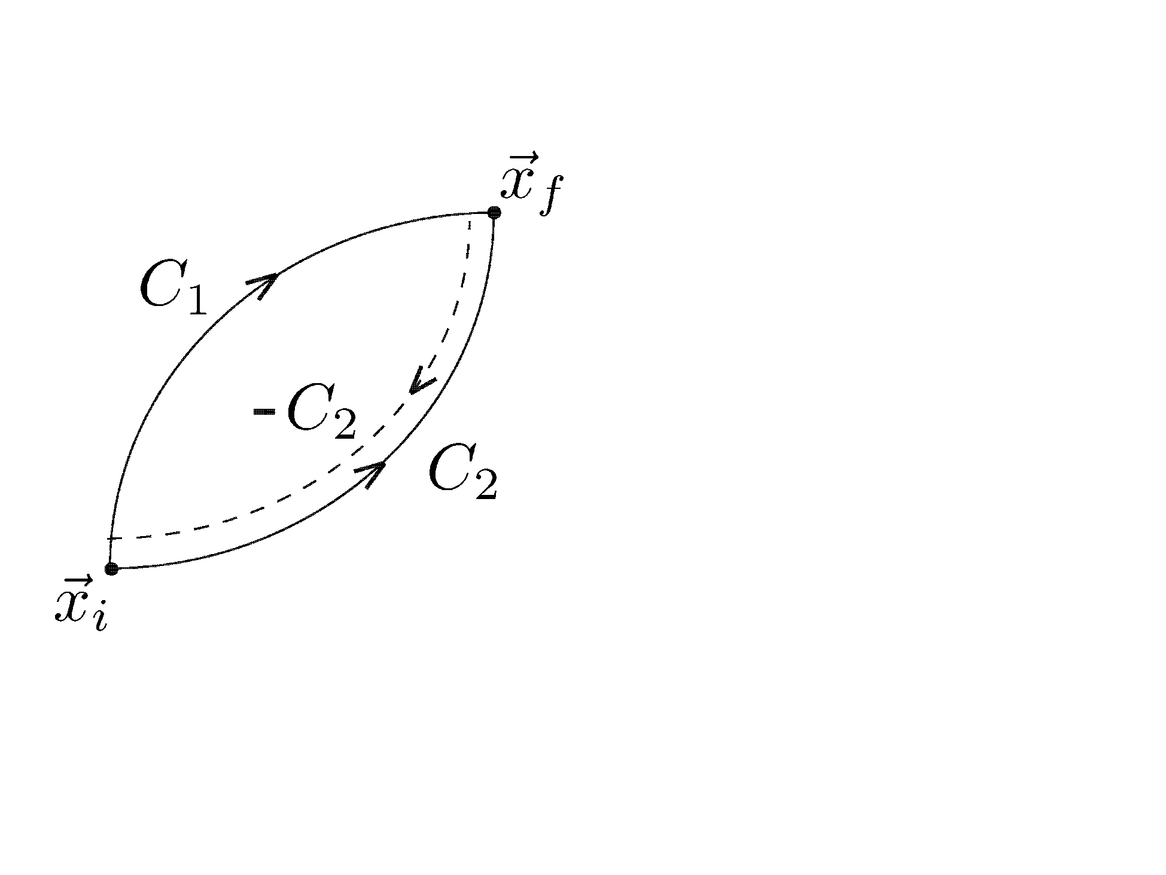

Path Independence
If F is conservative, then $ΔU=U\left({\vec{x}}_{f}\right)−U({\vec{x}}_{i})$ is independent of the path.
$$\oint_{C_{1}−C_{2}}{\vec{F}⋅d\vec{x}=0} \\ \int_{C_{1}}{\vec{F}⋅d\vec{x}}+\int_{−C_{2}}{\vec{F}⋅d\vec{x}}=0$$
$$\int_{C_{1}}{\vec{F}⋅d\vec{x}}−\int_{C_{2}}{\vec{F}⋅d\vec{x}}=0$$
$$→ \int_{C_{1}}{\vec{F}⋅d\vec{x}}=\int_{C_{2}}{\vec{F}⋅d\vec{x}}$$

Slide 13
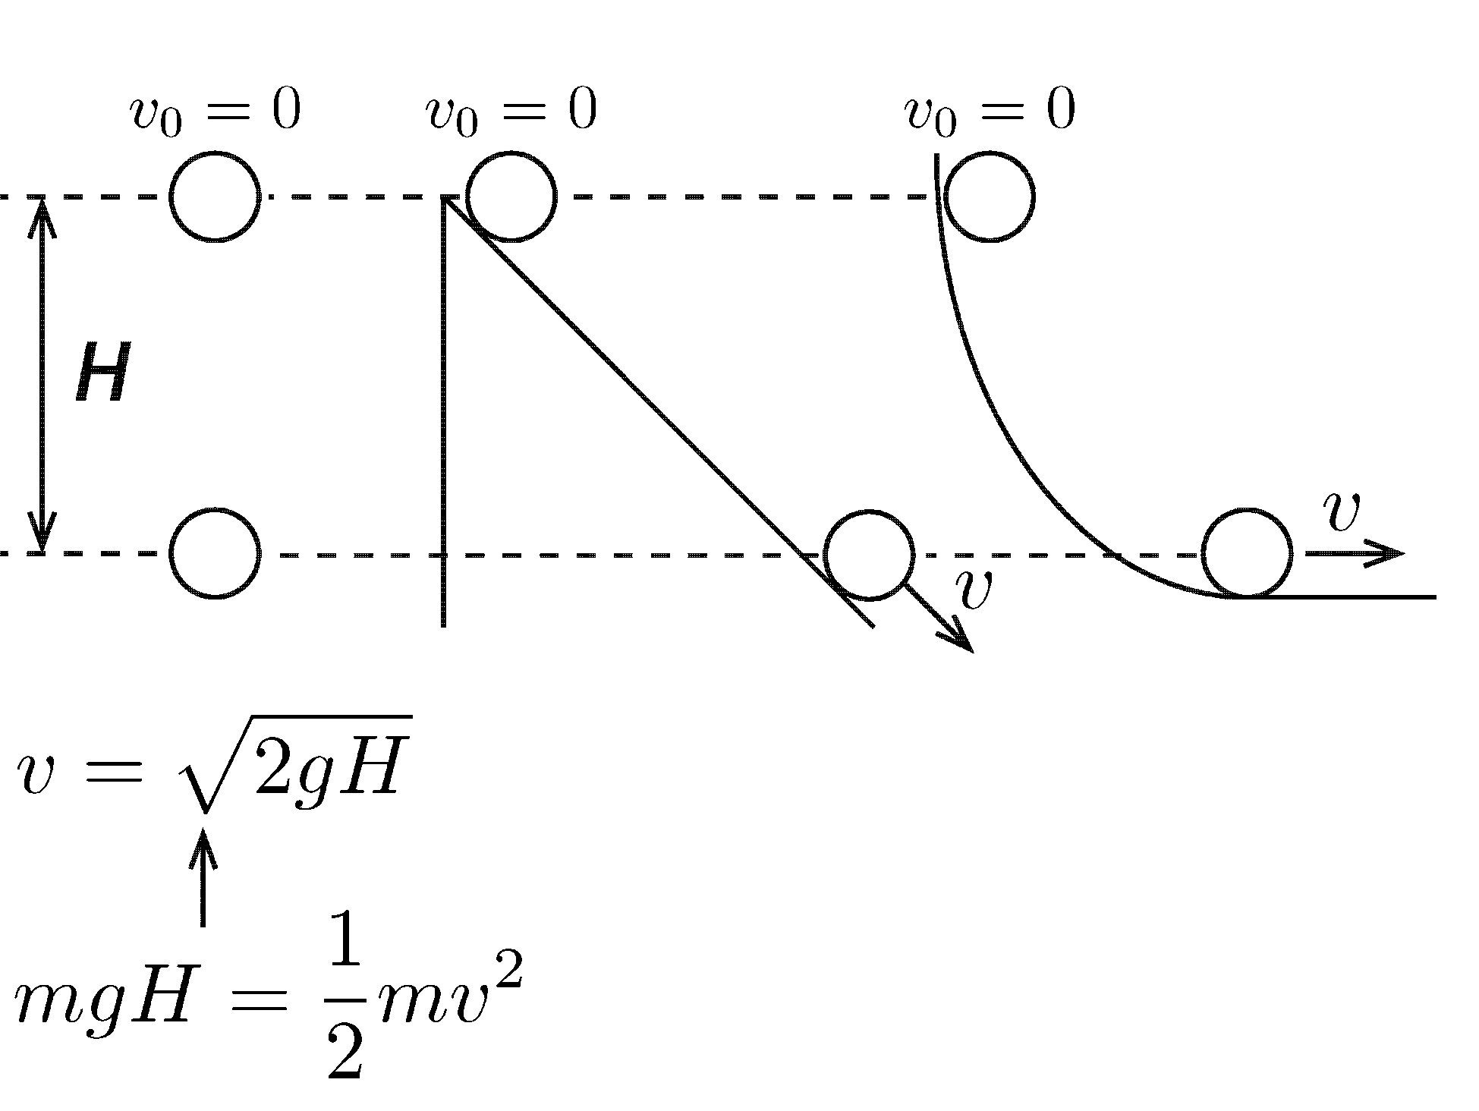
Exercise
Speed (kinetic energy) is independent of the path!

Slide 14
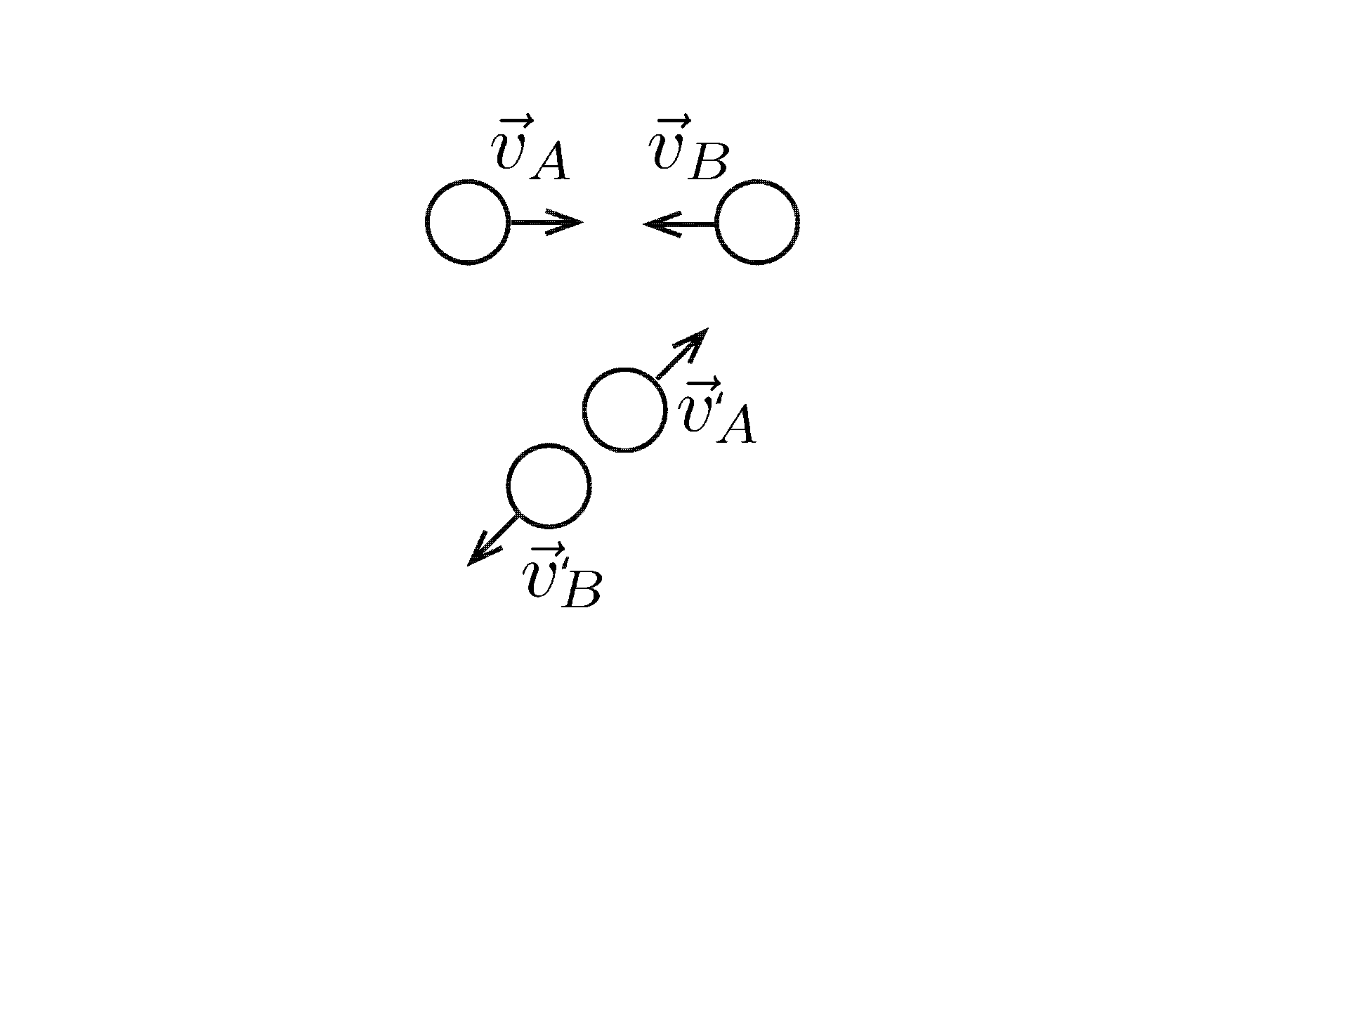
Elastic Collision
Elastic : Kinetic energy is conserved
Inelastic : Kinetic energy is lost Completely inelastic : Kinetic energy is maximally lost

Slide 15
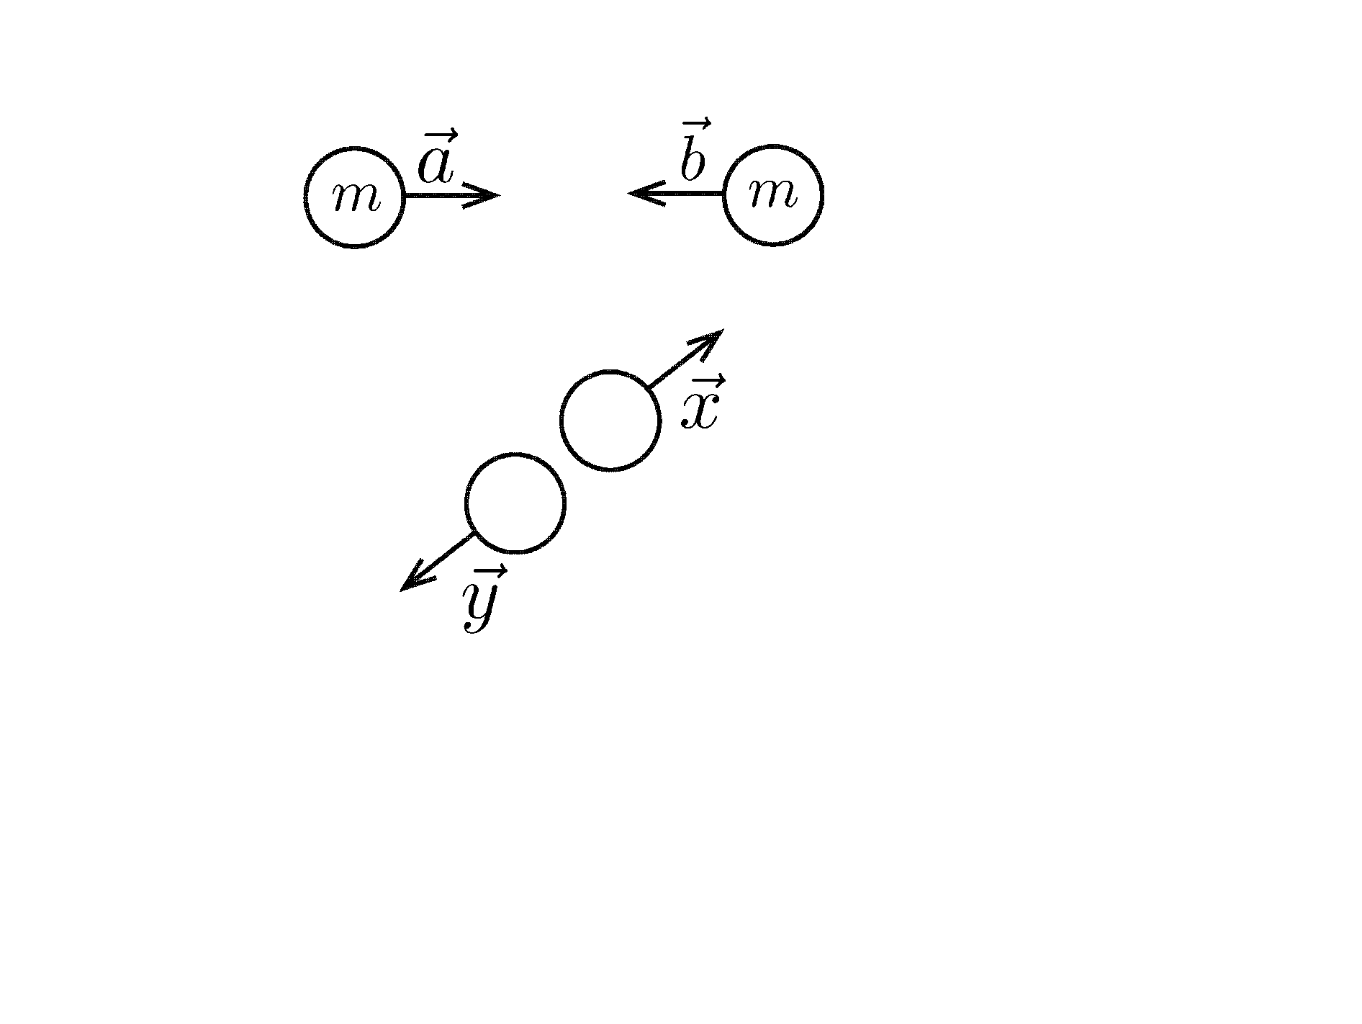
Elastic Collision of identical particles
initial velocities
final velocities
Momentum conservation : $m\vec{a}+m\vec{b}=m\vec{x}+m\vec{y}$
$→\vec{a}+\vec{b}=\vec{x}+\vec{y}$
Energy conservation : $\frac{1}{2}ma^{2}+\frac{1}{2}mb^{2}=\frac{1}{2}mx^{2}+\frac{1}{2}my^{2}$
$→a^{2}+b^{2}=x^{2}+y^{2}$

Slide 16
1-D case
$$a +b =x+y→a−x=−\left(b−y\right) \\ a^{2}+b^{2}=x^{2}+y^{2}→a^{2}−x^{2}=−\left(b^{2}−y^{2}\right) \\ →\left(a+x\right)\left(a−x\right)=−\left(b+y\right)\left(b−y\right) \\ a+x=b+y$$
$$a+x=b+y$$
$$a+x=b+y$$
+
-
$$a−x=−b+y$$
$$a−x=−b+y$$
$$2a=2y$$
$$2x=2b$$
$$∴y=a \& x=b$$
Velocities are exchanged !

Slide 17
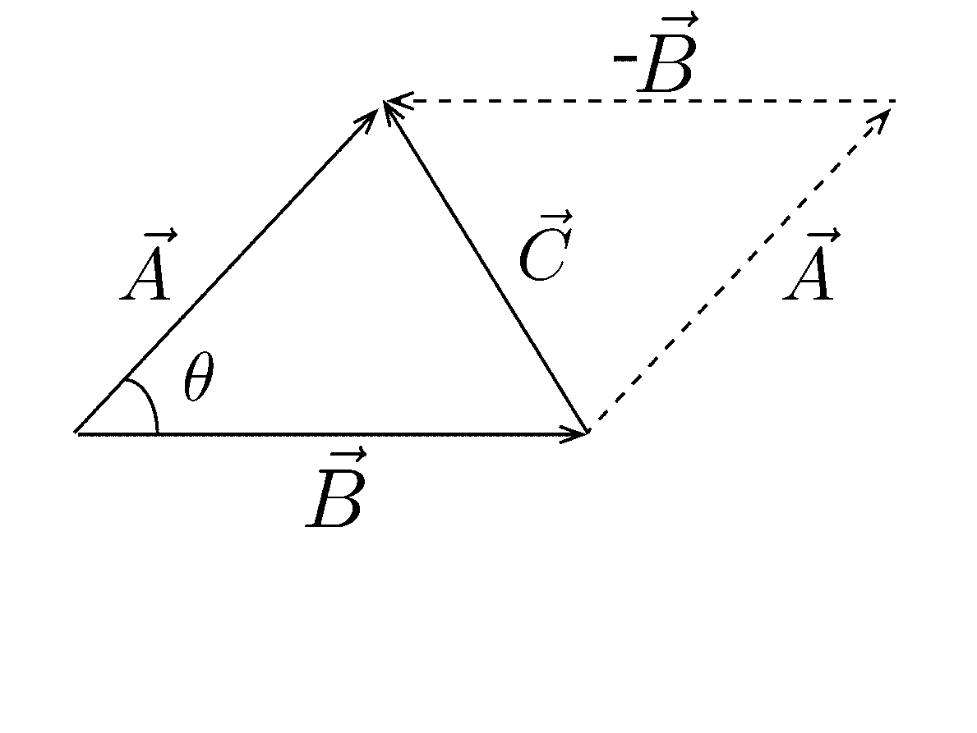
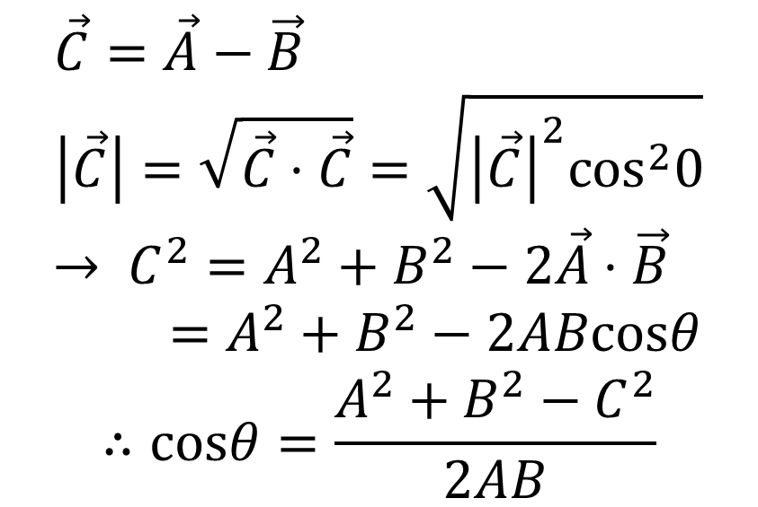
Scalar product and cosine law
$$\vec{C}=\vec{A}−\vec{B} \\ \left|\vec{C}\right|=\sqrt{\vec{C}⋅\vec{C}}=\sqrt{{\left|\vec{C}\right|}^{2}\cos^{2}0}$$ $→ C^{2}=A^{2}+B^{2}−2\vec{A}⋅\vec{B}$ $$=A^{2}+B^{2}−2ABcosθ$$
$$∴cosθ=\frac{A^{2}+B^{2}−C^{2}}{2AB}$$
$$\vec{A}⋅\vec{B}=ABcosθ$$

Slide 18
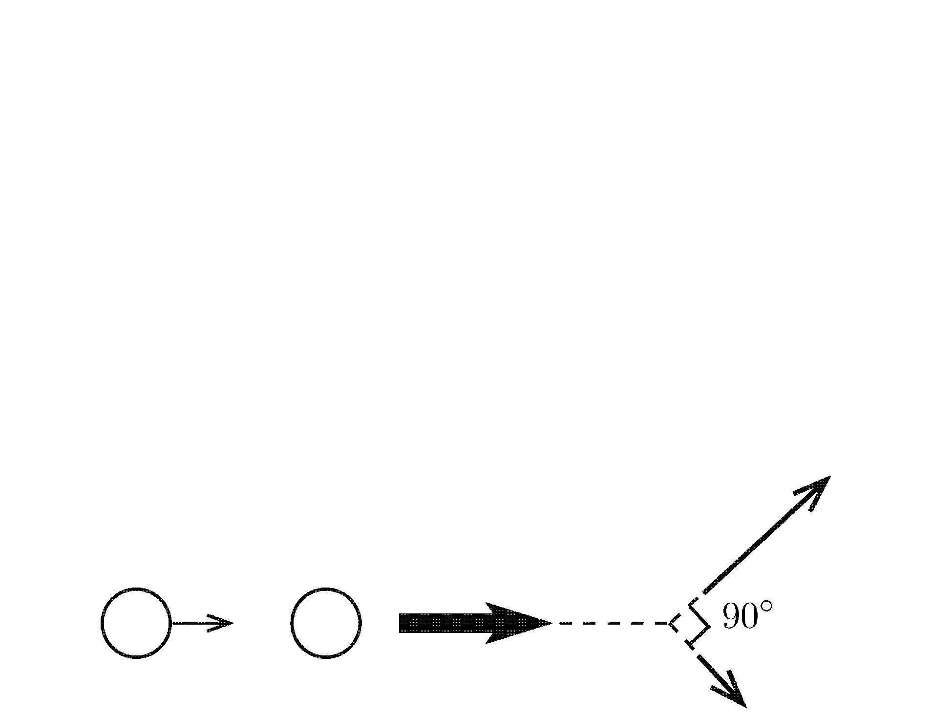
2-D case
$$\vec{a}+\vec{b}=\vec{x}+\vec{y} → \left(\vec{a}+\vec{b}\right)⋅\left(\vec{a}+\vec{b}\right)=\left(\vec{x}+\vec{y}\right)⋅\left(\vec{x}+\vec{y}\right) \\ a^{2}+b^{2}+2\vec{a}⋅\vec{b}=x^{2}+y^{2}+2\vec{x}⋅\vec{y} \\ a^{2}+b^{2}=x^{2}+y^{2}→ \vec{a}⋅\vec{b}=\vec{x}⋅\vec{y}$$
If $\vec{b}=\vec{0}$, then $\vec{x}⋅\vec{y}=0.$
$\vec{x}=0$ : head-on collision ($\vec{y}=\vec{a}$ ) $\vec{y}=0$ : no collision ($\vec{x}=\vec{a}$ ) $\vec{x}⊥\vec{y}$ :

Slide 19
Summary
Conservation of mass
Conservation of linear momentum
Conservation of mechanical energy

