Slide 1
Lorentz Transformation

Slide 2
Now we know that …
According to Michelson-Morley Experiment,
the speed of light is invariant.
2 important consequences:
time dilation and length contraction.
We believe that there must be a linear transformation that relates the space-time coordinates of any two inertial reference frame.
The transformation rules are called Lorentz transformation.
This week, we derive the transformation.

Slide 3
Linear Transformation

Slide 4
Linear Transformation
We have two variables x and y: ($x$, $y$)
For given constants $a, b, p, q$, we define
$x^{′}=ax+by$
$y^{′}=cx+dy$for every pair ($x$, $y$)
This transform from ($x$, $y$) to ($x′$, $y′$) is called a linear transformation.
In a matrix representation, we write
$X^{′}=AX, X=\left(\begin{matrix}x \\ y\end{matrix}\right),{ X}^{′}=\left(\begin{matrix}x^{′} \\ y^{′}\end{matrix}\right), A=\left(\begin{matrix}a & b \\ c & d\end{matrix}\right).$

Slide 5
Linear Transformation
$X^{′}=AX$: matrix form of linear equation
$X=\left(\begin{matrix}x \\ y\end{matrix}\right)$ : original coordinate column vector
$X^{′}=\left(\begin{matrix}x′ \\ y′\end{matrix}\right)$: transformed column vector
$A=\left(\begin{matrix}a & b \\ c & d\end{matrix}\right)$: transformation matrix

Slide 6
Why linear?
Suppose there are two column vectors $X$, $Y$. A linear combination of the vectors $X \& Y$, $αX+βY$transforms like $A\left(αX+βY\right)=α\left(AX\right)+β\left(AY\right)=αX^{′}+βY^{′},$
Because a linear combination transforms into the same linear combination except for the replacements $X→X^{′} \text{and} Y→Y′$, we call this the linear transformation.
Algebraic properties are preserved under a linear transformation.

Slide 7
2-step transformation
Consider two linear transformations $A$and $B$:
$\left(\begin{matrix}x′ \\ y′\end{matrix}\right)=A\left(\begin{matrix}x \\ y\end{matrix}\right), A=\left(\begin{matrix}a & b \\ c & d\end{matrix}\right)$,
$\left(\begin{matrix}x′′ \\ y′′\end{matrix}\right)=B\left(\begin{matrix}x′ \\ y′\end{matrix}\right), B=\left(\begin{matrix}p & q \\ r & s\end{matrix}\right)$,
Then the transform $\left(x,y\right)→(x^{′′},y^{′′})$
is represented by the matrix $C=BA$ such that
$$\left(\begin{matrix}x′′ \\ y′′\end{matrix}\right)=C\left(\begin{matrix}x \\ y\end{matrix}\right),$$
$$C=BA=\left(\begin{matrix}p & q \\ r & s\end{matrix}\right)\left(\begin{matrix}a & b \\ c & d\end{matrix}\right)=\left(\begin{matrix}pa+qc & pb+qd \\ ra+sc & rb+sd\end{matrix}\right)$$

Slide 8
Inverse Transformation
For a linear transformation matrix $A$
$\left(\begin{matrix}x′ \\ y′\end{matrix}\right)=A\left(\begin{matrix}x \\ y\end{matrix}\right), A=\left(\begin{matrix}a & b \\ c & d\end{matrix}\right)$,
If there exists a matrix $B$ such that
$\left(\begin{matrix}x \\ y\end{matrix}\right)=B\left(\begin{matrix}x′ \\ y′\end{matrix}\right), B$is called the inverse of $A$
and we write $B=A^{−1}.$

Slide 9
Inverse Matrix
If $det(A)≠0$, there exists the inverse $A^{−1}=\frac{1}{det(A)}\left(\begin{matrix}d & −b \\ −c & a\end{matrix}\right)$ where $det(A)$ = $ad−bc$ for a 2 x 2 matrix.
If $det\left(A\right)≠0,$ then the number of dimension is preserved under the transformation.
If $det\left(A\right)=0$, then the number of dimension decreases and the inverse transform does not exist.

Slide 10
$$AA^{−1}=A^{−1}A=1$$
The 2-step transform $\left(x,y\right)→(x^{′},y^{′})$ $→(x,y)$
is represented by
$$\left(\begin{matrix}x \\ y\end{matrix}\right)=A^{−1}A\left(\begin{matrix}x \\ y\end{matrix}\right).$$
The 2-step transform $\left(x′,y′\right)→(x,y)$ $→(x′,y′)$
is represented by
$$\left(\begin{matrix}x′ \\ y′\end{matrix}\right)=AA^{−1}\left(\begin{matrix}x′ \\ y′\end{matrix}\right).$$
It is trivial to show that ${AA}^{−1}=A^{−1}A=\text{1},$
where 1$=\left(\begin{matrix}1 & 0 \\ 0 & 1\end{matrix}\right)$ is the identity matrix.

Slide 11
Rotational Transformation

Slide 12
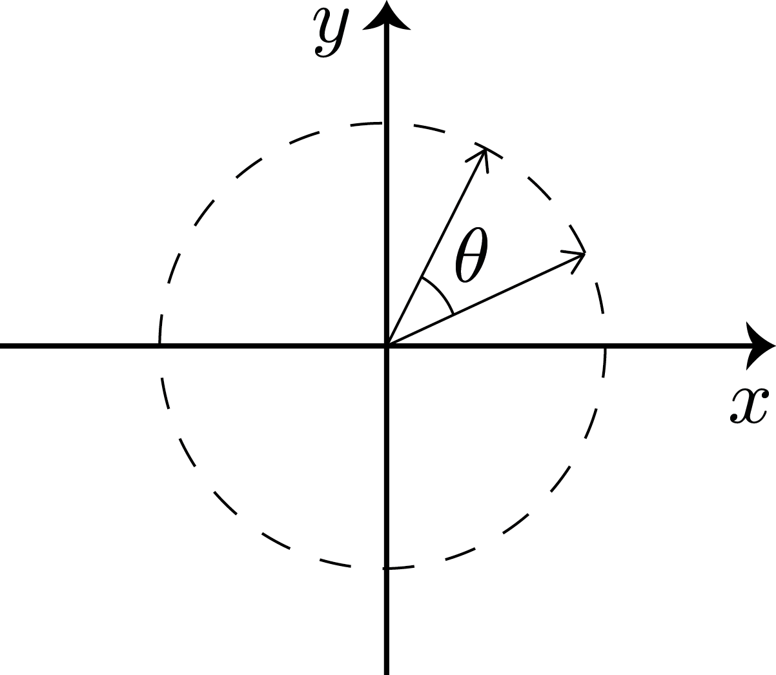
Rotational Transformation
As a specific example of the linear transformation, we study rotation of two dimensional Euclidean vectors.
As shown in the figure, vector $X$is rotated by an angle $θ.$ The resultant vector is $X′$.
We want to find the matrix $R$ that satisfying
$X^{′}=RX$.
$$X^{′}=\left(\begin{matrix}x′ \\ y′\end{matrix}\right)$$
$$X=\left(\begin{matrix}x \\ y\end{matrix}\right)$$

Slide 13
Invariant under Rotation
$$X^{′}=\left(\begin{matrix}x′ \\ y′\end{matrix}\right)$$
Under rotation, the direction of a vector changes. Therefore, each component may change under rotation.
$$X=\left(\begin{matrix}x \\ y\end{matrix}\right)$$
However, the length of the vector, which behaves like the radius of a circle, is invariant under rotation.
$$X^{′2}=x^{′2}+y^{′2}=x^{2}+y^{2}=X^{2}$$

Slide 14
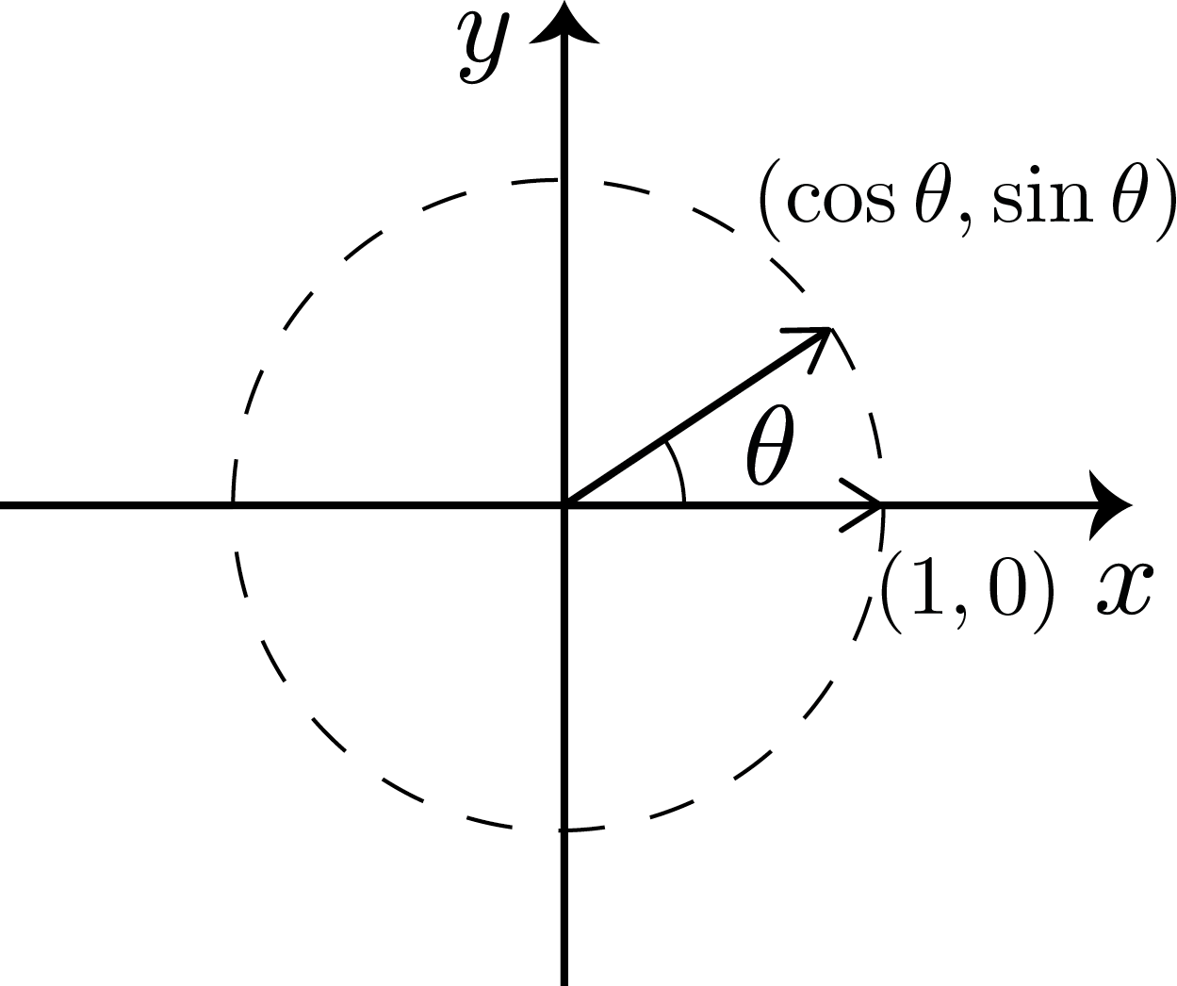
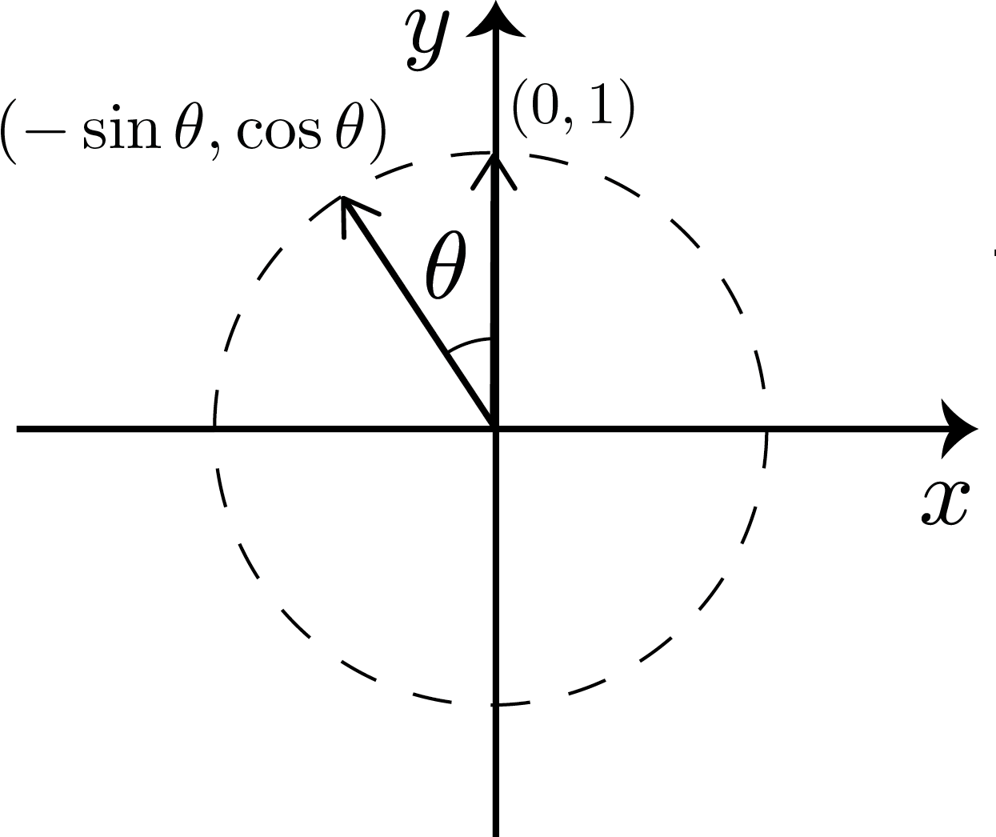
How to determine R
Once we know how unit vectors along x and y axes transform, we can determine R!
$$\left(\begin{aligned}1 \\ 0\end{aligned}\right)→\left(\begin{aligned}\cos{θ} \\ \sin{θ}\end{aligned}\right)=R\left(\begin{aligned}1 \\ 0\end{aligned}\right)$$
$$\left(\begin{aligned}0 \\ 1\end{aligned}\right)→\left(\begin{aligned}−\sin{θ} \\ \cos{θ}\end{aligned}\right)=R\left(\begin{aligned}0 \\ 1\end{aligned}\right)$$

Slide 15
Explicit form of R in 2D
From the constraints $\left(\begin{aligned}\cos{θ} \\ \sin{θ}\end{aligned}\right)=R\left(\begin{aligned}1 \\ 0\end{aligned}\right)$ and $\left(\begin{aligned}−\sin{θ} \\ \cos{θ}\end{aligned}\right)=R\left(\begin{aligned}0 \\ 1\end{aligned}\right),$ we finally determine the matrix $R$: $R=\left(\begin{matrix}\cos{θ} & −\sin{θ} \\ \sin{θ} & \cos{θ}\end{matrix}\right)$
Note that the polar angle $θ$ is measured from the x axis anti-clockwise.

Slide 16
Usage of matrix R
Linear property of the rotation allows us to generalize our finding:
$\left(\begin{matrix}x′ \\ y′\end{matrix}\right)=\left(\begin{matrix}\cos{θ} & −\sin{θ} \\ \sin{θ} & \cos{θ}\end{matrix}\right)\left(\begin{matrix}x \\ y\end{matrix}\right)=\left(\begin{matrix}x\cos{θ}−y\sin{θ} \\ x \sin{θ+}y\cos{θ}\end{matrix}\right)$
It is easy to show that the length of the vector is preserved under rotation: $x^{′2}+y^{′2}=\left(\cos^{2}{θ+\sin^{2}{θ)(x^{2}}}+y^{2}\right)=x^{2}+y^{2}$

Slide 17
Inverse of Rotational Matrix
The matrix R transforms the vector X into X’. The inverse matrix $R^{−1}$returns X’ into X.
According to relativity between the two vectors, the inverse matrix can be obtained simply by replacing the parameter $θ$ with $−θ:$
$R=\left(\begin{matrix}\cos{θ} & −\sin{θ} \\ \sin{θ} & \cos{θ}\end{matrix}\right)$
$R^{−1}=R\left[θ→−θ\right]=\left(\begin{matrix}\cos{θ} & \sin{θ} \\ −sin{θ} & \cos{θ}\end{matrix}\right)$

Slide 18
We can verify
$R^{−1}X^{′}=\left(\begin{matrix}\cos{θ} & \sin{θ} \\ −sin{θ} & \cos{θ}\end{matrix}\right)\left(\begin{matrix}x′ \\ y′\end{matrix}\right)$ $=\left(\begin{matrix}x′\cos{θ+y′ sin θ} \\ −x^{′}sin θ+y^{′}cos θ\end{matrix}\right)=\left(\begin{matrix}x \\ y\end{matrix}\right)=X$
$R^{−1}X^{′}=\left(\begin{matrix}\cos{θ} & \sin{θ} \\ −sin{θ} & \cos{θ}\end{matrix}\right)\left(\begin{matrix}\cos{θ} & −\sin{θ} \\ \sin{θ} & \cos{θ}\end{matrix}\right)\left(\begin{matrix}x \\ y\end{matrix}\right)$ $=\left(\begin{matrix}\cos^{2}{θ}+\sin^{2} θ & 0 \\ 0 & \cos^{2}{θ}+\sin^{2} θ\end{matrix}\right)\left(\begin{matrix}x \\ y\end{matrix}\right)$ $=\left(\begin{matrix}x \\ y\end{matrix}\right)=X$

Slide 19
Transpose Matrix
Note that for the inverse matrix $R$, $R^{−1}=\left(\begin{matrix}\cos{θ} & \sin{θ} \\ −sin{θ} & \cos{θ}\end{matrix}\right)={\left(\begin{matrix}\cos{θ} & −\sin{θ} \\ \sin{θ} & \cos{θ}\end{matrix}\right)}^{T}=R^{T}$, where the symbol T represents the transpose.
For any matrix $A=\left(\begin{matrix}a & b \\ c & d\end{matrix}\right)$, the corresponding transpose $A^{T}$ is defined as $A^{T}={\left(\begin{matrix}a & b \\ c & d\end{matrix}\right)}^{T}=\left(\begin{matrix}a & c \\ b & d\end{matrix}\right)$.
It is trivial to show that ${(A^{T})}^{T} =A$

Slide 20
Vector Transpose
We can also define the transpose of a column vector as $X^{T}={\left(\begin{aligned}x \\ y\end{aligned}\right)}^{T}=\left(x y\right).$
Then the length of a vector can be represented as the matrix multiplication of $X^{T}$ and $X$.
$$X^{T}X=\left(x y\right)\left(\begin{aligned}x \\ y\end{aligned}\right)=x^{2}+y^{2}$$

Slide 21
Orthogonality of R
Note that a rotation matrix satisfies $R^{−1}=R^{T}.$
Such a matrix is called an orthogonal matrix.
If a vector transforms under an orthogonal matrix $R$ such that $R^{−1}=R^{T}(R^{T}R=RR^{T}=1)$, then the length of the vector is always invariant. $X^{′T}X^{′}={\left(RX\right)}^{T}\left(RX\right)=\left(X^{T}R^{T}\right)\left(RX\right)$ $=X^{T}\left(R^{T}R\right)X=X^{T}1 X=X^{T}X$
Note that ${\left(AB\right)}^{T}=B^{T}A^{T}$

Slide 22
$${[R\left(θ\right)]}^{2}=R(2θ)$$
We learned that if we apply $R$ to a vector, then the vector is rotated through the angle $θ.$ Let us apply $R$ one more time. $X^{′′}=RX^{′}=R^{2}X$
The repeated application of $R$, can be regarded as a single rotation through the angle $2θ$. $R^{2}=\left(\begin{matrix}\cos{θ} & −\sin{θ} \\ \sin{θ} & \cos{θ}\end{matrix}\right)\left(\begin{matrix}\cos{θ} & −\sin{θ} \\ \sin{θ} & \cos{θ}\end{matrix}\right)=\left(\begin{matrix}\cos{θcos θ−sin θsin θ} & −2 sin{θcosθ} \\ 2 sin{θcos θ} & \cos{θcos θ−sin θsin θ}\end{matrix}\right)=\left(\begin{matrix}\cos{2θ} & −\sin{2θ} \\ \sin{2θ} & \cos{2θ}\end{matrix}\right)=R(2θ)$

Slide 23
$$R\left(β\right)R(α)=R(α+β)$$
Suppose we rotate by an angle $α$ and then about $β.$ Then the resultant rotation is by an angle $α+β$.
$$R\left(β\right)R\left(α\right)=\left(\begin{matrix}cos β & −\sin{β} \\ \sin{β} & cos β\end{matrix}\right)\left(\begin{matrix}\cos{α} & −\sin{α} \\ sin α & \cos{α}\end{matrix}\right)$$
$$=\left(\begin{matrix}\cos{α cosβ−sinα sinβ} & −( sin{α cosβ}+cosα sinβ) \\ \sin{α cosβ}+cosα sin β & \cos{α cosβ−sinα sinβ}\end{matrix}\right)=R\left(α+β\right)=\left(\begin{matrix}\cos{(α+β) } & −\sin{(α+β)} \\ \sin{(α+β)} & \cos{(α+β)}\end{matrix}\right)$$
This derives useful trigonometric formulas:.
$\cos\left(α+β\right)$ $=$ $\cos{α cosβ−sinα sinβ}$
$\sin{(α+β)}$ $=$ $\sin{α cosβ}+cosα sinβ$

Slide 24
$${[R\left(θ\right)]}^{n}=R(nθ)$$
By making use of previous trigonometric formulas and applying mathematical induction, it is straightforward to show that
$${ R}^{n}=\left(\begin{matrix}\cos{nθ} & −\sin{nθ} \\ \sin{nθ} & \cos{nθ}\end{matrix}\right).$$
This relation is very important when we study the Lorentz transformation.

Slide 25
A Question
Suppose a linear transformation $A$ transforms the unit vector $\left(\begin{aligned}1 \\ 0\end{aligned}\right)$ into $A\left(\begin{aligned}1 \\ 0\end{aligned}\right)=\left(\begin{aligned}a \\ b\end{aligned}\right)$.
If we assume the orthogonality of $A$, then under what conditions does $A$ exist?
Is $A$ unique once it exists?
What is the explicit form of $A$?
Answer: If $a^{2}+b^{2}≠1,$ $A$ does not exist. If $a^{2}+b^{2}=1$, $A=\left(\begin{matrix}a & −b \\ b & a\end{matrix}\right)$ or $A=\left(\begin{matrix}a & b \\ b & −a\end{matrix}\right)$.

Slide 26
Parity Transformation of Reflection
Show that $A=\left(\begin{matrix}a & b \\ b & −a\end{matrix}\right)$ is not expressed as the rotational matrix.
If we set either $a=0$ or $b=0,$ it is easy to notice that this transform is not a rotation but a reflection. Explain graphically.

